Slide 1
Cell Biology Bingo
Visualizing human cells with the Allen Institute for Cell Science
Notes:
Note: slide order is not randomized on each play-through of the slideshow

Slide 2
Cell structure bingo introduction
Identify cell structures to complete your bingo card! Every structure is on every card.
Images are of human induced pluripotent stem cells
Stem cells = cells that develop into other, more specialized types of cells.
Pluripotent stem cells = a type of stem cell that can become almost any type of cell in the body. Other stem cells can only become certain cell types, like hemopoietic stem cells – they can only become different types of blood cells.
Induced stem cells = cells that were a specialized cell type, and through a chemical process are turned back into stem cells. These cells come from a skin cell sample that was turned back into stem cells.
Resources to learn cell structure appearance and functions:
Visual Guide to Human Cells: allencell.org/visual-guide-to-human-cells
Cell Structure Observations: allencell.org/cell-observations

Slide 3
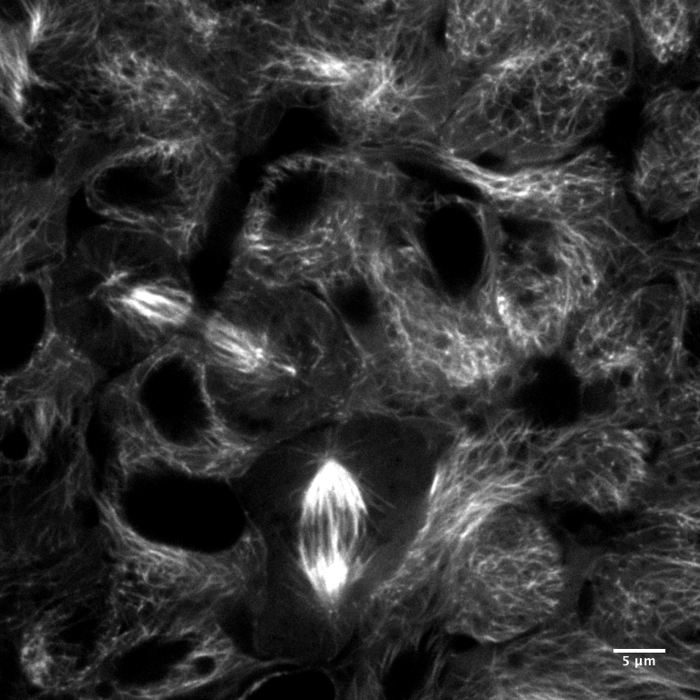
This structure is part of the cytoskeleton and is especially important in transporting materials throughout the cell
When cells divide, this structure also helps with chromosome separation
Hint: this structure’s name comes from the tubulin proteins that it is made of
Notes:
Microtubules

Slide 4
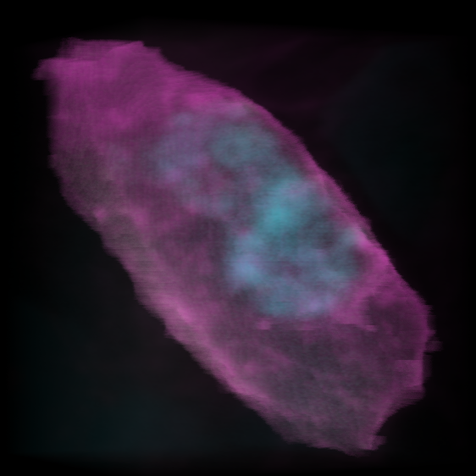
The genetic material of the cell
Contains genes that give instructions for how to produce proteins
Shown in blue in this image
Notes:
DNA

Slide 5
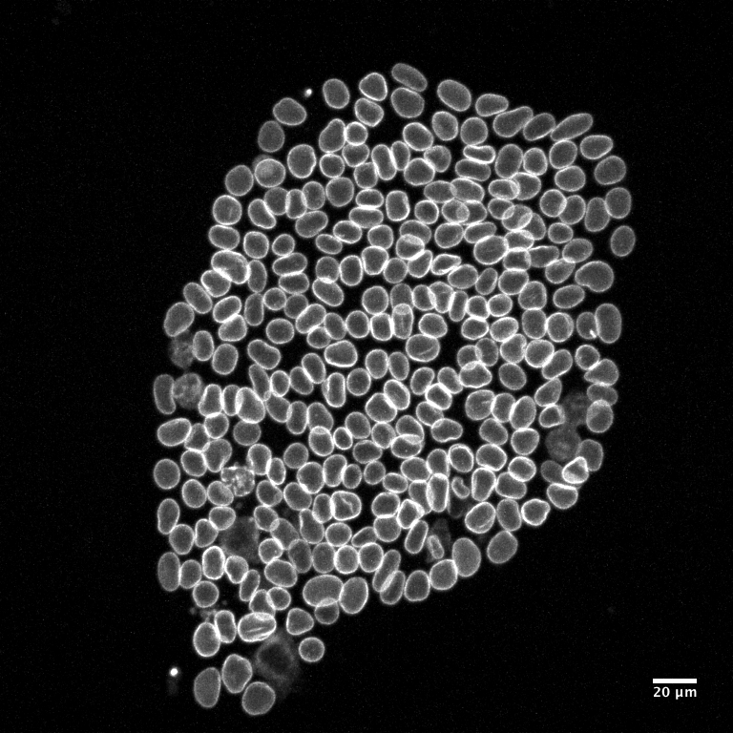
This membrane layer separates the rest of the cell from the DNA, proteins that organize the chromosomes, and RNA in the process of being transcribed
It connects to the endoplasmic reticulum
Notes:
Nuclear envelope

Slide 6
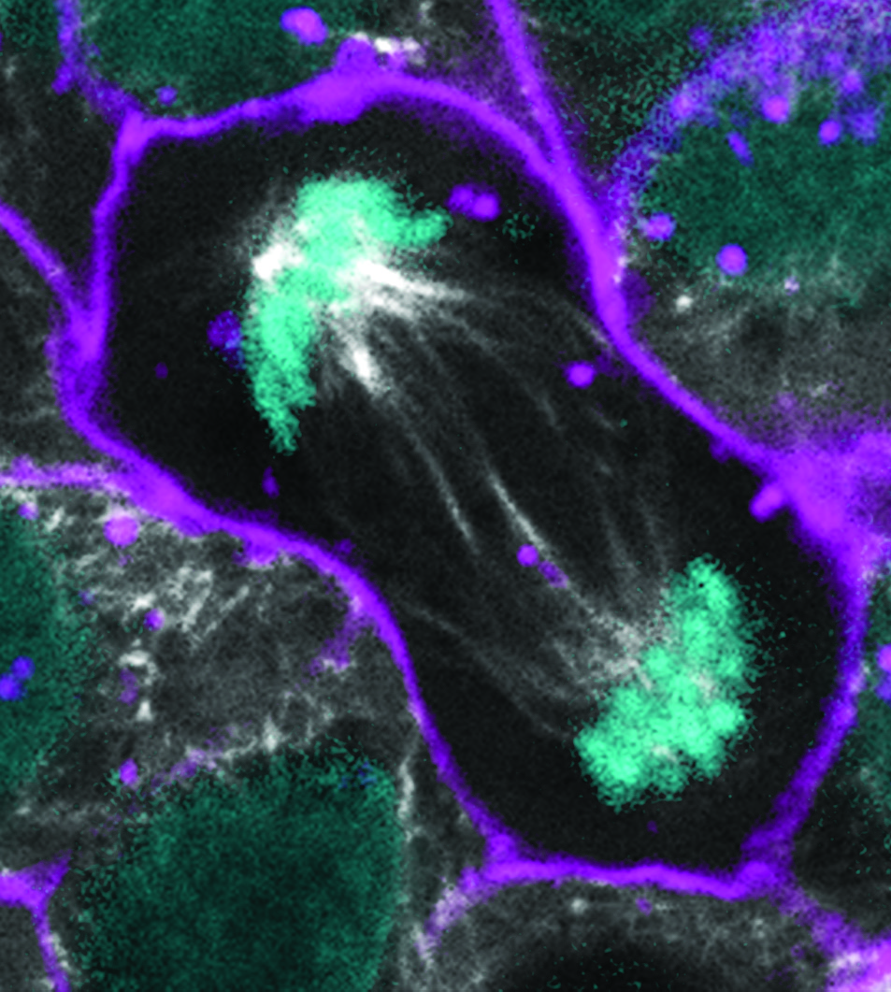
The last stage of mitosis before cytokinesis
A new nucleus forms around each set of chromosomes
The nucleus re-forms
Notes:
Telophase

Slide 7
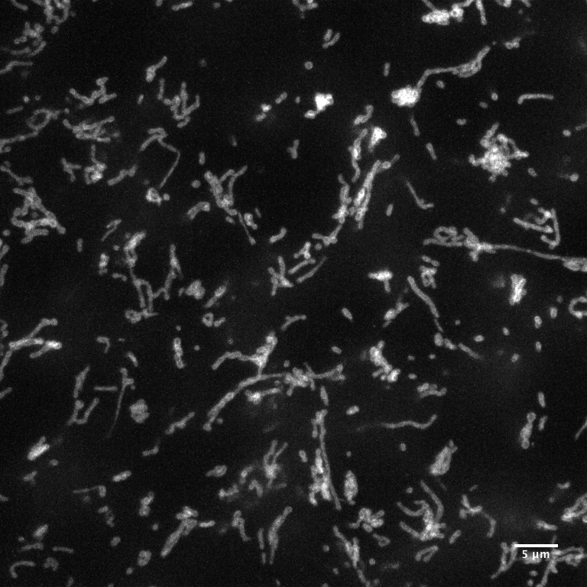
Produces ATP for cell energy through cellular respiration (“the powerhouse of the cell”)
Has two membranes
Has its own DNA separate from the nuclear DNA, which is only inherited from the mother
Notes:
Mitochondria

Slide 8
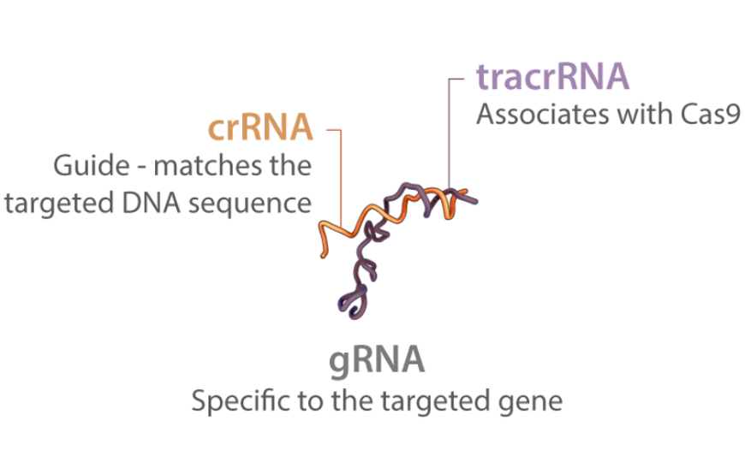
A method for editing the genes of a cell to add a fluorescent tag, edit the gene sequence, or add a new gene
Its developers won the Nobel Prize in 2020
Notes:
CRISPR

Slide 9
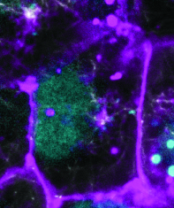
The phase between cell division cycles
Cells spend most of their lives in this phase
Notes:
Interphase

Slide 10
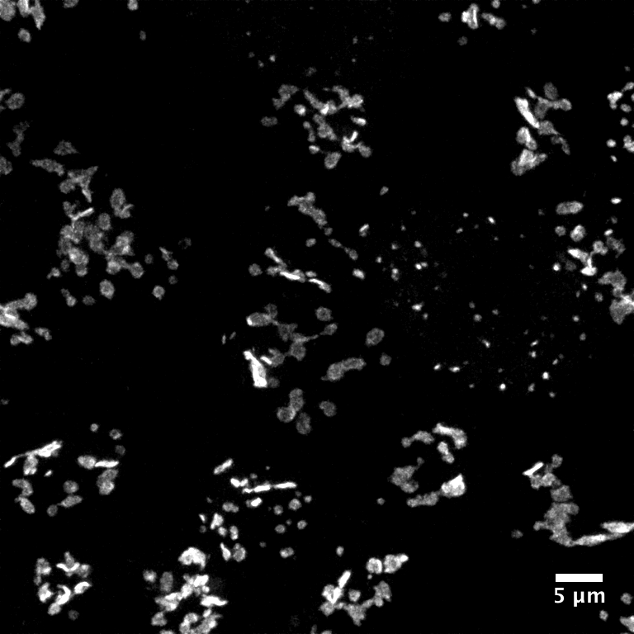
This structure prepares, sorts, and packages proteins and lipids that were built by the endoplasmic reticulum
It manages protein alterations like cleaving and glycosylation
After this structure has done its job, proteins are ready for use in the cell or to be secreted out of the cell
Notes:
Golgi bodies

Slide 11
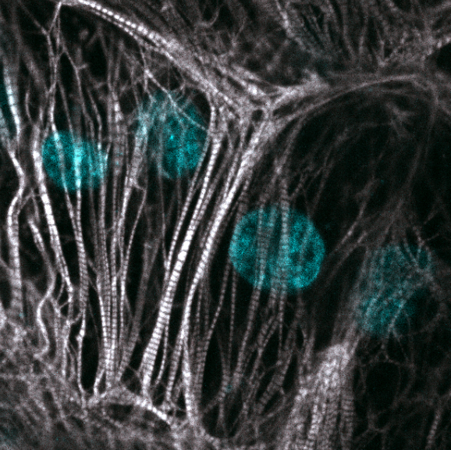
The process where stem cells become specialized cells
This process occurs over the lifetime of the organism
The cells in the picture are cardiomyocytes, or heart muscle cells, grown in a lab from stem cells from an adult
Notes:
Differentiation

Slide 12
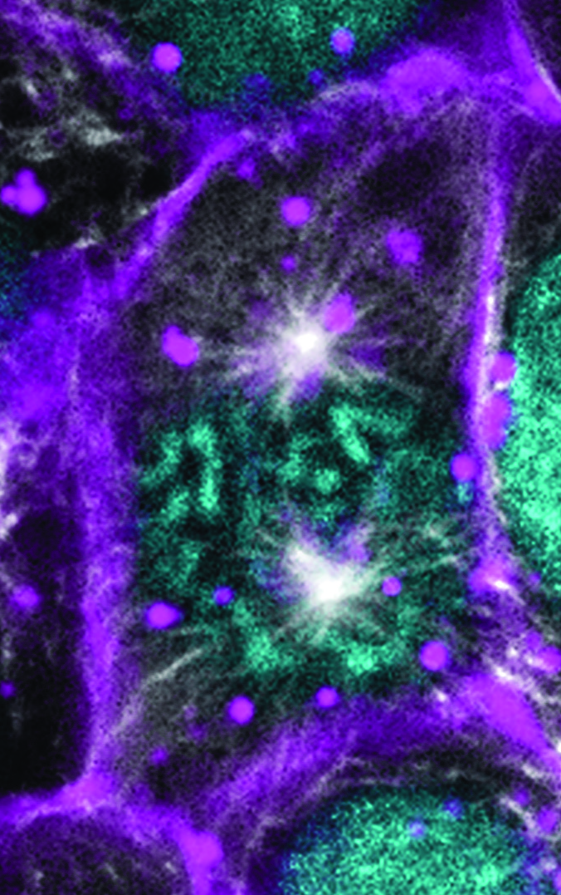
The first stage of cell division
The chromosomes condense and the spindle starts to appear
The centrosomes move to opposite ends of the nucleus
Notes:
Prophase

Slide 13
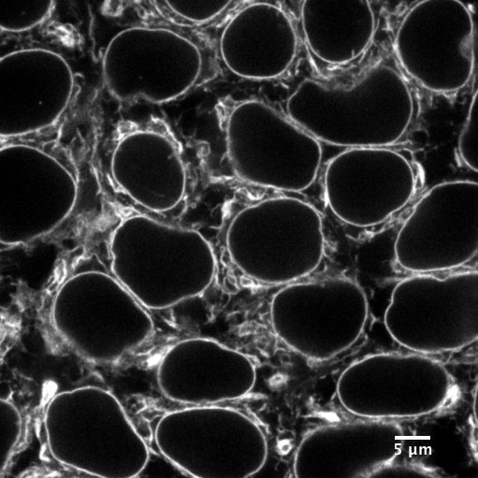
This structure synthesizes proteins and lipids based on mRNA received from the nucleus
It also helps store calcium and break down toxins
There are rough and smooth varieties of this structure
Notes:
Endoplasmic reticulum

Slide 14
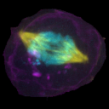
The shortest step of mitosis
The spindle fibers pull the chromosomes apart and move them to the opposite poles of the nucleus
Notes:
Anaphase

Slide 15
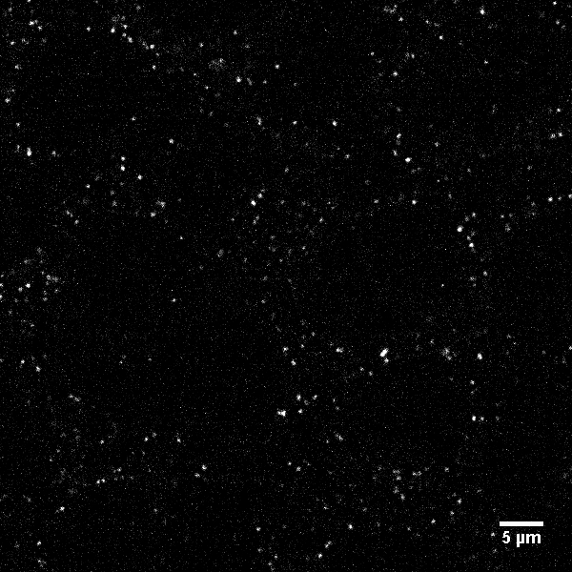
This structure helps break down fatty acids and synthesize lipids
Some cell functions create harmful hydrogen peroxide as a byproduct, which this structure helps clean up (hint: this is related to the structure’s name)
Notes:
Peroxisomes

Slide 16
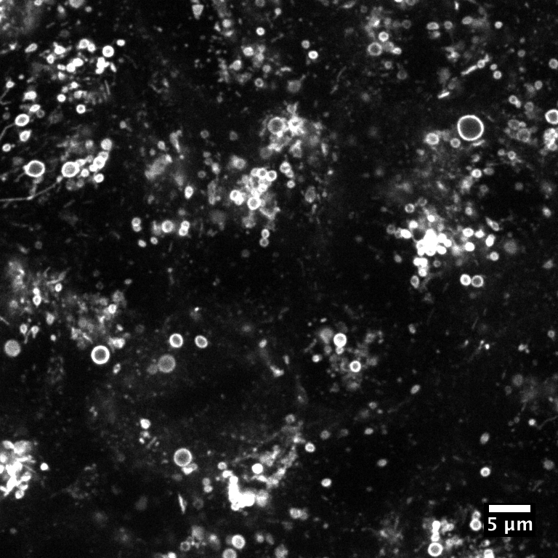
These structures break down waste in the cell and save materials for reuse
They can travel throughout the whole cell to go where they are needed
Notes:
Lysosomes

Slide 17
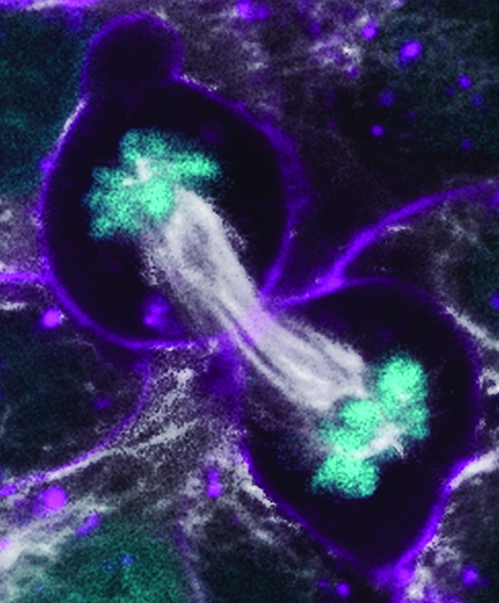
Following the last phase of mitosis, the where the cytoplasm and organelles completely separate into two new cells
This usually happens at the end of the process of mitosis, but not always, leading to multi-nucleus cells
Notes:
Cytokinesis

Slide 18
A group of microtubules that helps organize chromosomes
Helps produce the mitotic spindle during mitosis
Notes:
Centrioles

Slide 19
A group of repeated nucleotides found at the end of a chromosome
Helps prevent chromosomes from degrading
Gets shorter with age
Notes:
Telomeres

Slide 20
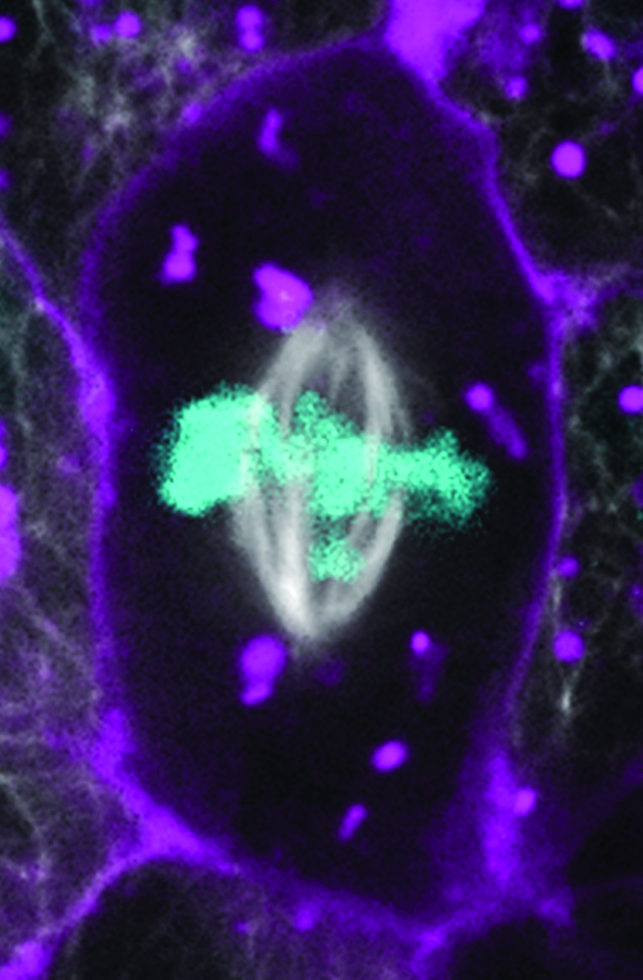
A middle stage of mitosis
The spindle fibers attach to the chromosomes and help them line up halfway between the centromeres
The cell checks to make sure the chromosomes have lined up and attached to the spindles before continuing
Notes:
Metaphase

Slide 21
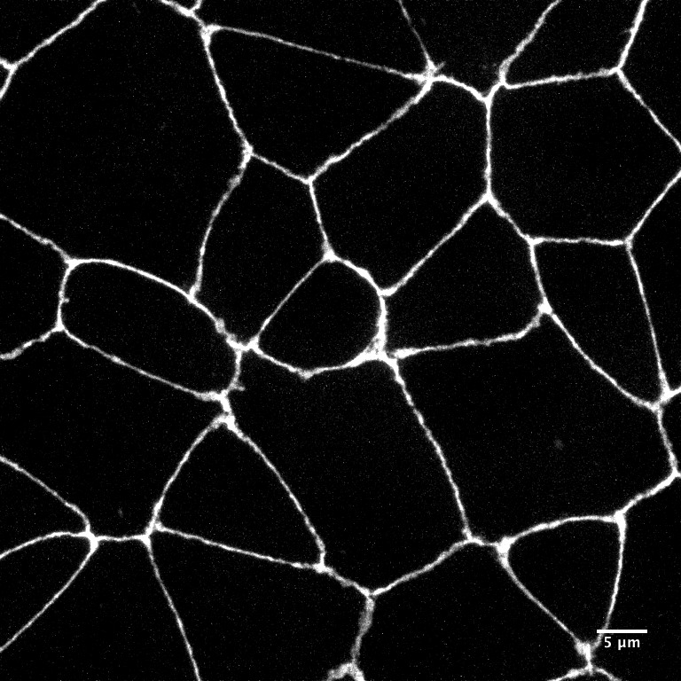
In these areas, cells are bound together with proteins that connect their membranes
This helps cells sense their neighbors and environment
They also connect to the cytoskeleton and help the cells maintain their shape
Notes:
Tight junctions

Slide 22
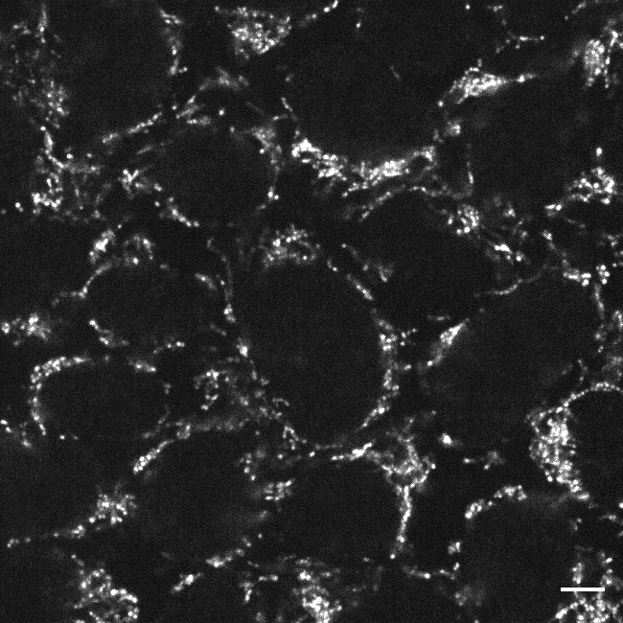
Located inside of another cell structure that is associated with respiration/energy production
The location of additional genetic material in the cell
Notes:
Mitochondrial nucleoids

Slide 23
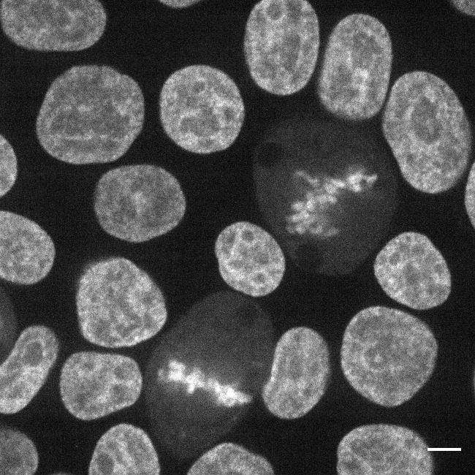
This protein binds to DNA and helps regulate the expression of genes
It helps control the amount of mRNA produced from a section of DNA
Hint: this protein’s name tells you about its function
Notes:
Transcription factor

Slide 24
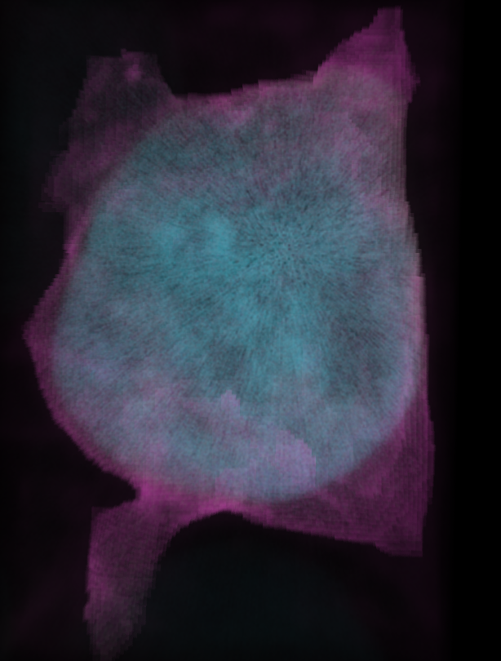
The fluid filling the interior of the cell
Organelles, structures, and proteins are found in this space
Notes:
Cytosol

Slide 25
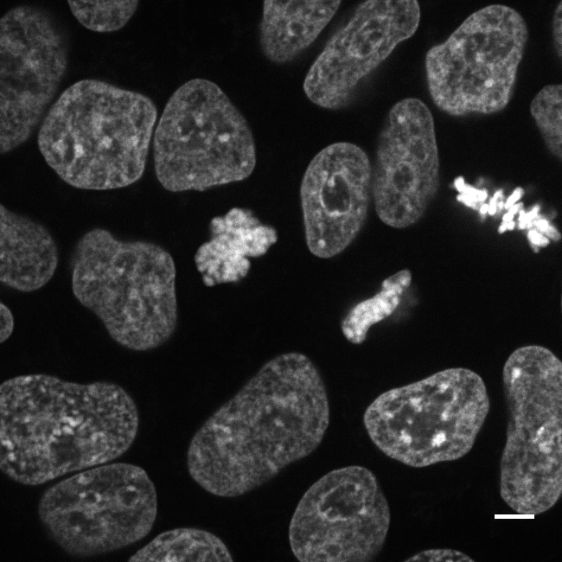
This protein helps spool up DNA inside of the cell nucleus
It helps keep DNA neat and prevents it from becoming damaged or tangled
Notes:
Histones

Slide 26
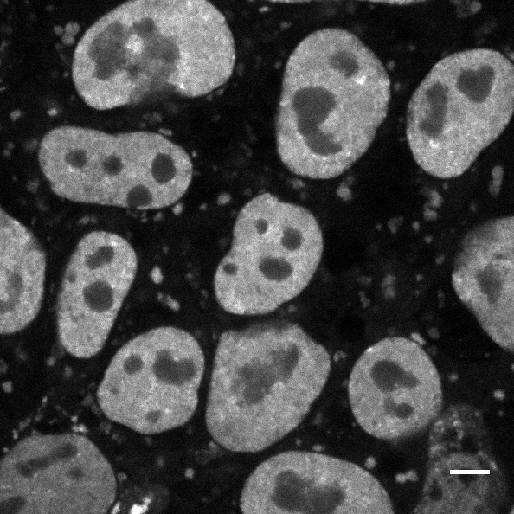
These clusters of proteins and RNA appear when a cell is under strain from its environment
They float in the cytosol and are made of untranslated mRNA
Hint: these clusters’ name comes from what causes them
Notes:
Stress granules

