Slide 1
Neuroscience Bingo
Visualizing the brain with the Allen Institute for Brain Science and Allen Institute MindScope Program
Notes:
Choose one of slides 1-4 as your title slide

Slide 2
Neuroscience bingo introduction
Identify cells, structures, and concepts in neuroscience to make bingo! Every image is on every card.
The images in this bingo game include data from human and mouse brains taken with a variety of techniques:
Light microscopy techniques – cells/tissue that have been dyed or stained before being imaged under a standard light microscope.
Fluorescent microscopy techniques – cells/tissue that have had fluorescent dyes or probes applied, or were genetically modified to be fluorescent.
Electron microscopy – images taken with a beam of electrons rather than with light, producing images with molecular-level resolution.
Digital reconstructions and models – some images are of digital reconstructions based on real data, which enables quantification.

Slide 3
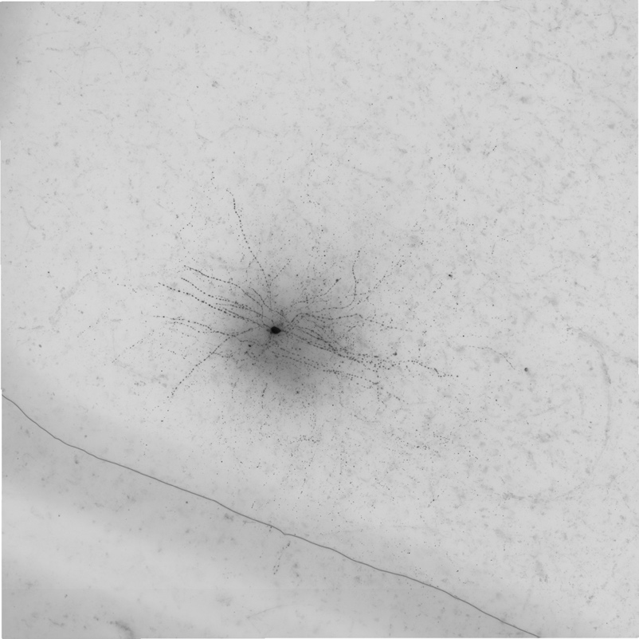
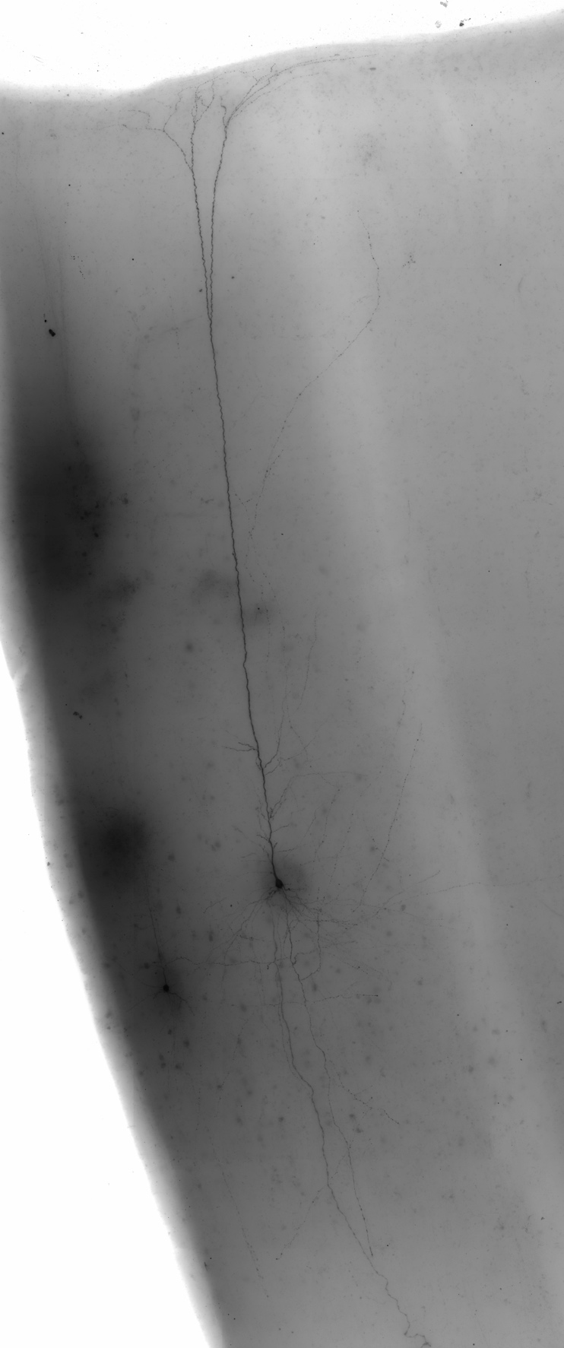
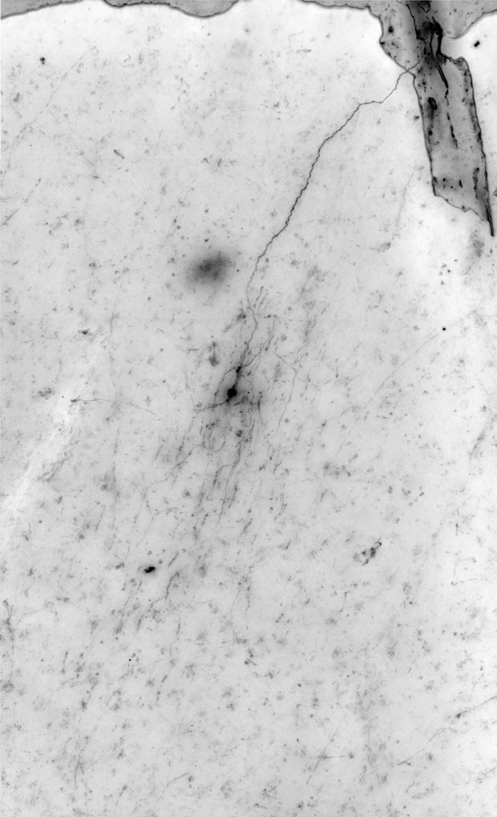
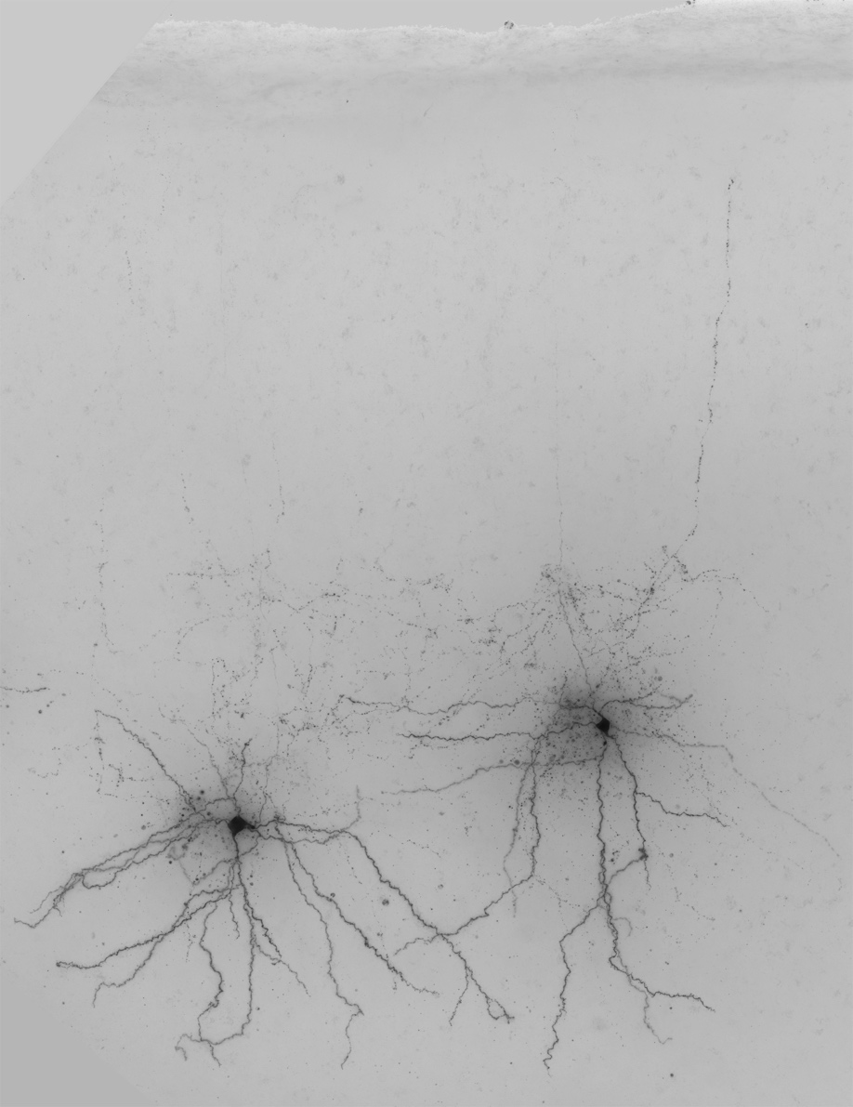
The type of cell that carries signals and performs computations in the brain, receives information from sensory organs, sends signals to muscles, and more
Also commonly known as “brain cells” or “nerve cells”
Within this category, there are over 150 types of this cell found in humans
Image information: some different types of this cell, as labeled
Basket
Extratelencephalic
Chandelier
Sst
Notes:
Neuron. Cell types, from left: Extratelencelphalic, Sst (bottom), basket (top), chandelier.

Slide 4
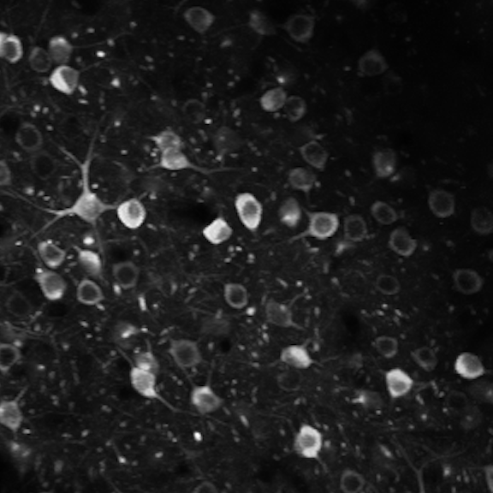
The electrical signal traveling along the length of a neuron
Produced by the electrochemical properties of the cell membrane and ion flowing in and out of the cell
Sometimes described as a neuron “firing” or “spiking”
Frequently measured with electrodes
Image information: other methods of measuring this signal include measuring the fluorescence produced by special genetically-modified ion channels that glow when this signal is produced
Notes:
Action potential

Slide 5
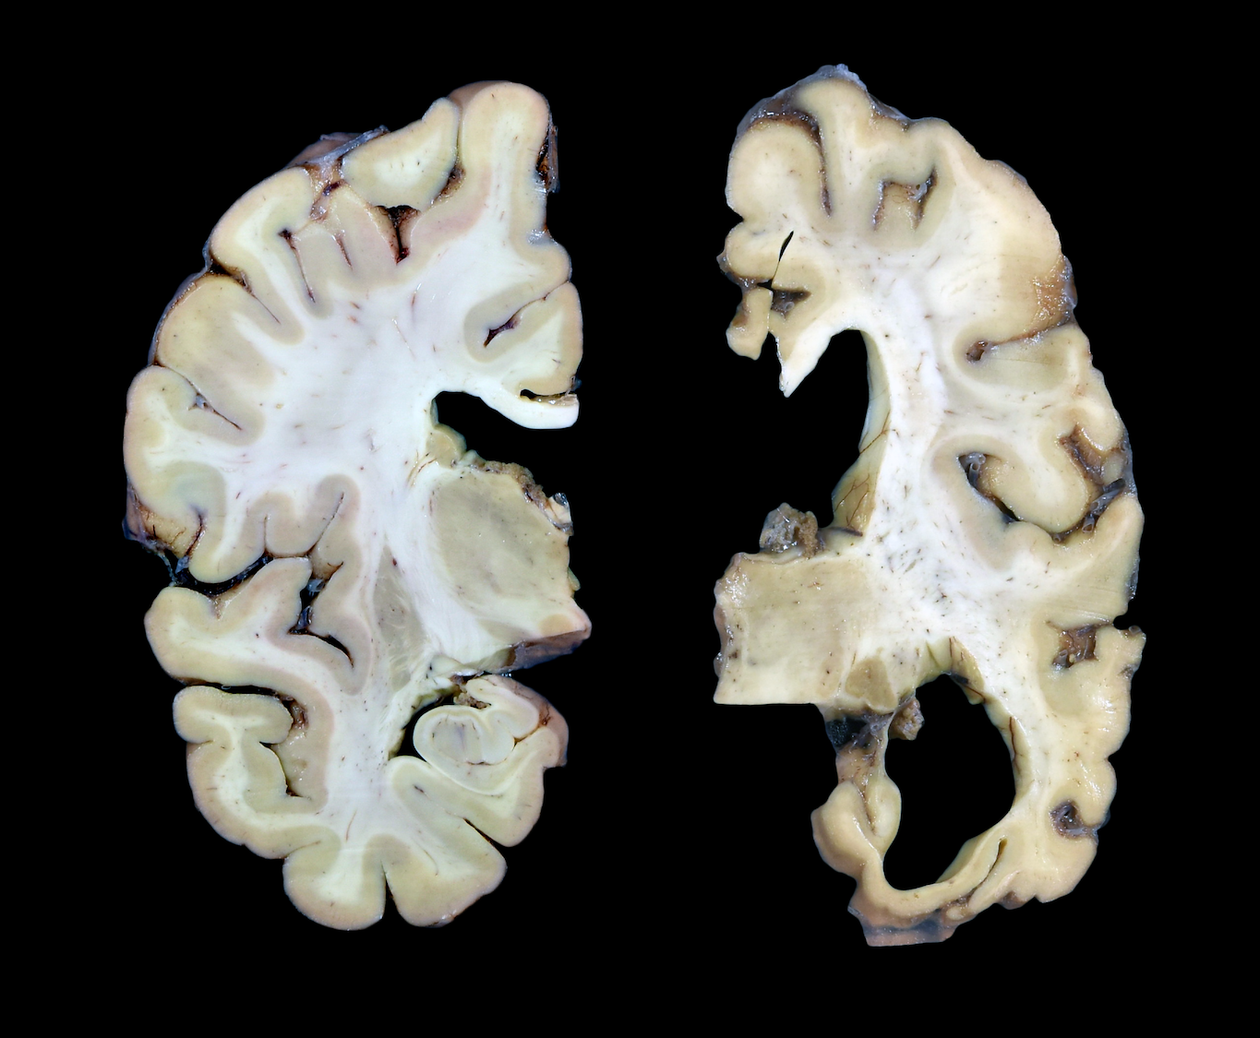
The most common form of dementia
This neurodegenerative disease causes neurons to die, especially in the hippocampus and cortex
Tangles of tau protein and plaques beta-amyloid protein cause cell death
Cognitive symptoms include memory difficulties, disorientation, and other executive function challenges
Image information: the brain tissue sample on the left is from an individual with no known neurological conditions, and the sample on the right is from an individual with this disease
Notes:
Alzheimer’s

Slide 6
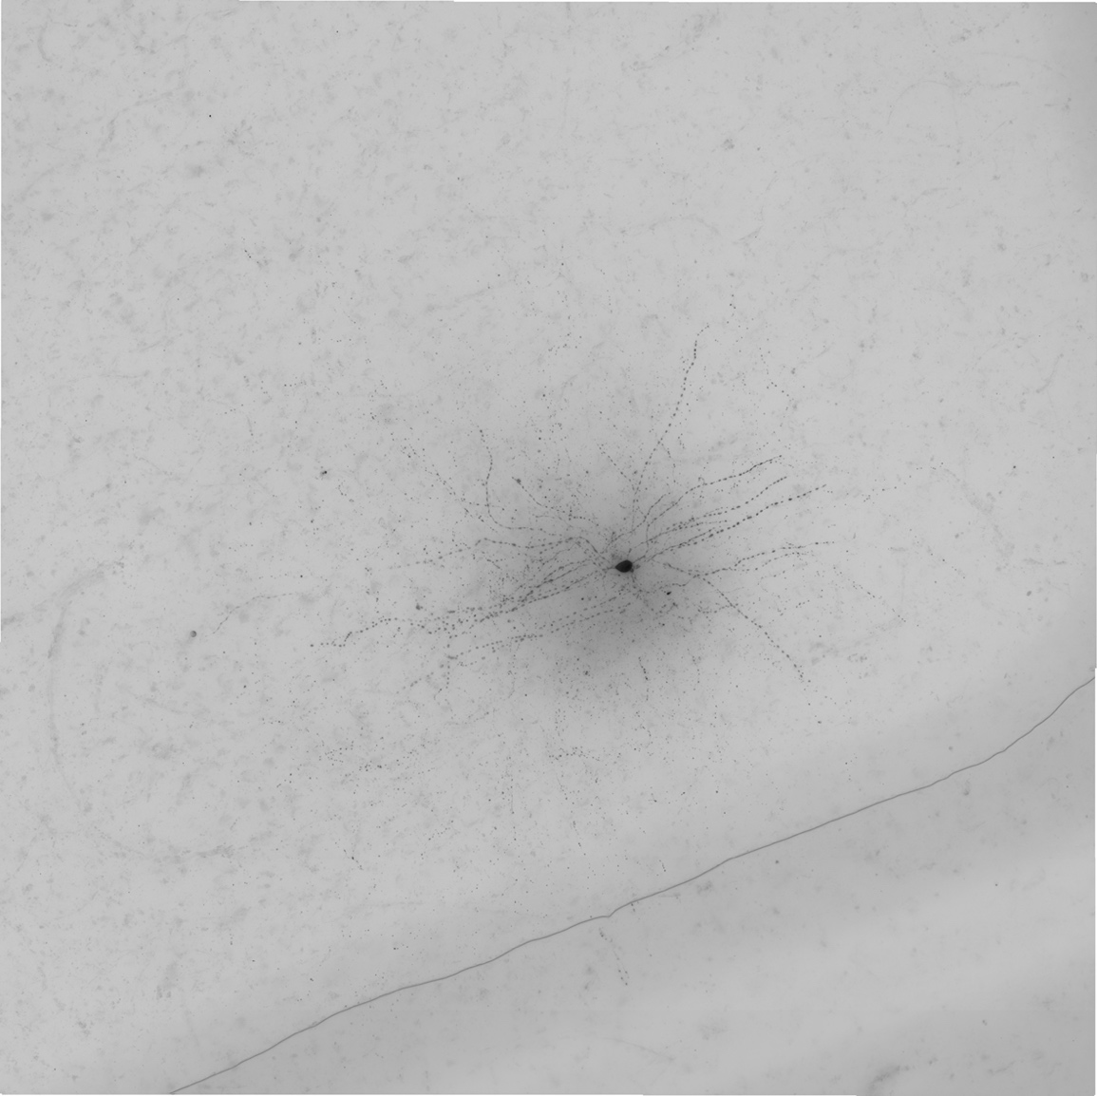
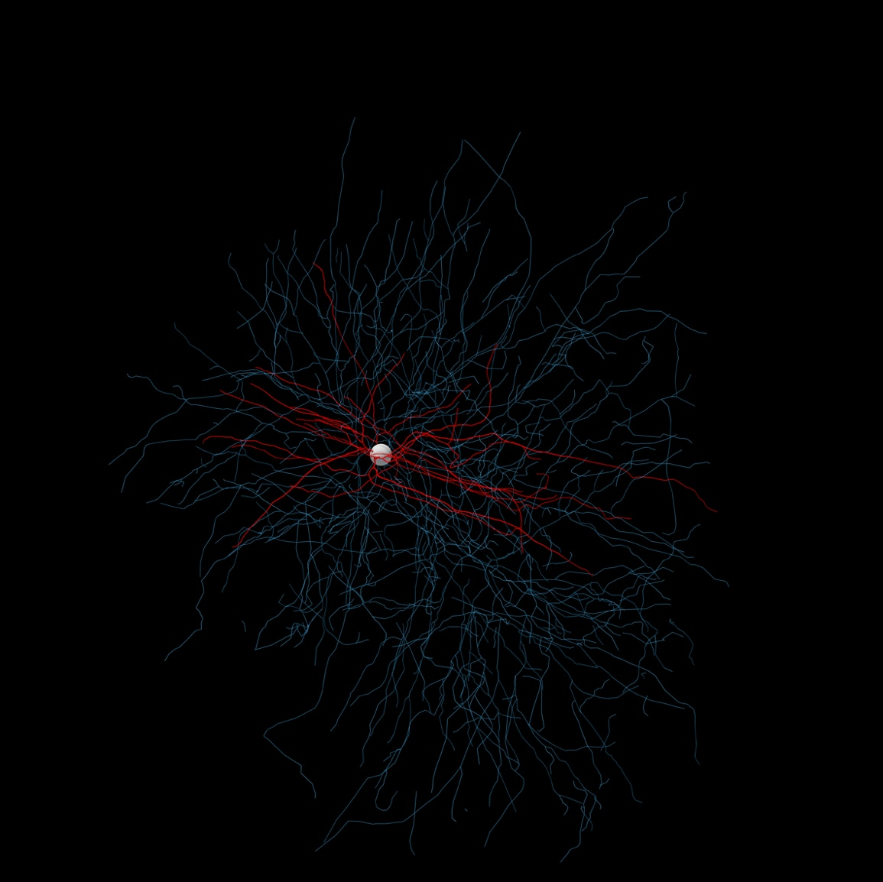
Neuron under microscope
A projection or projections from a neuron that carry signals to other cells and pass that signal at their terminals to other cells
They are part of neurons both inside the brain and across the body
The shortest of these projections travel very small distances between neurons in the brain, and the longest (the sciatic nerve) travels the entire length of the leg
Digital reconstruction of same neuron, blue marks this structure
Notes:
Axon

Slide 7
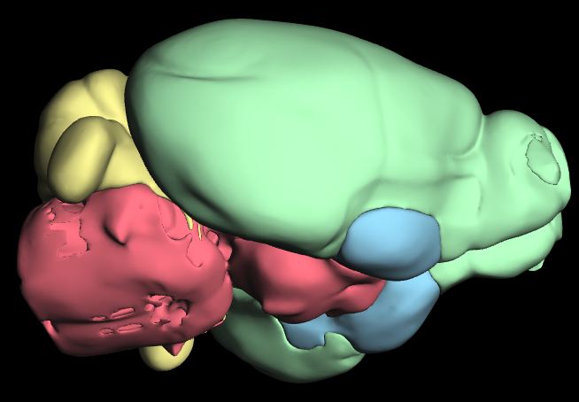
The part of the brain that interfaces with the spinal cord and controls basic, life-critical functions
Subsections include the midbrain, pons, and medulla
Sensory information from the body and motor commands to the body pass through here as the route to the spinal cord
Critical functions managed by this region include regulating respiration, heart rate, digestion, and sleep/wake cycle
Region marked in red
Notes:
Brainstem

Slide 8
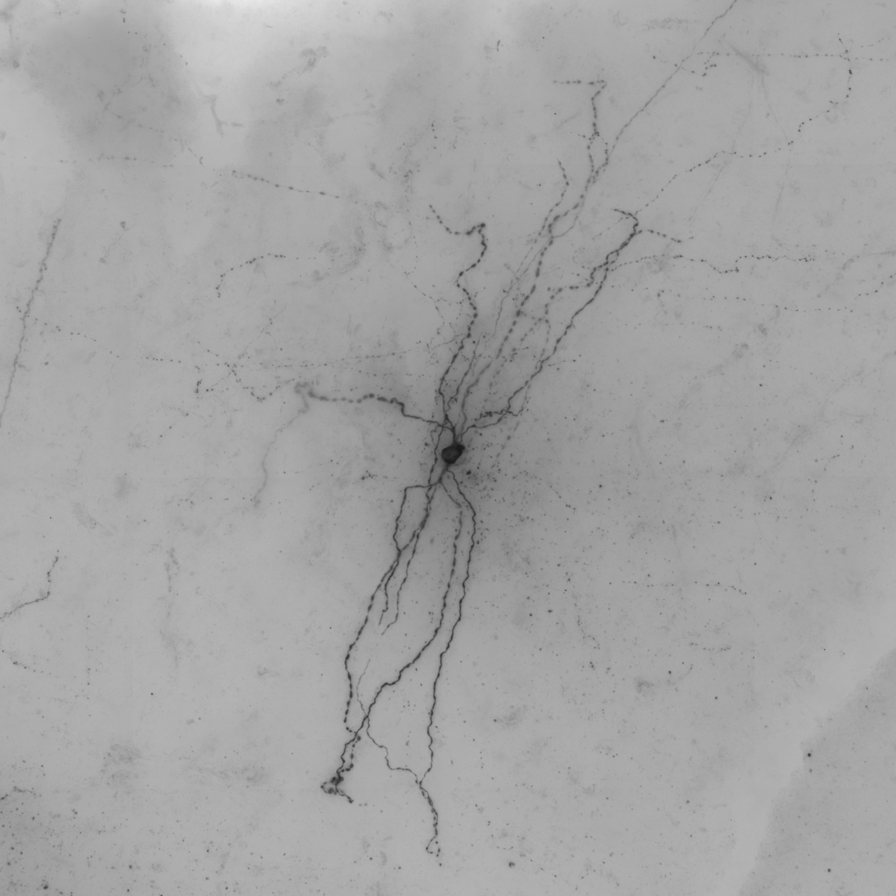
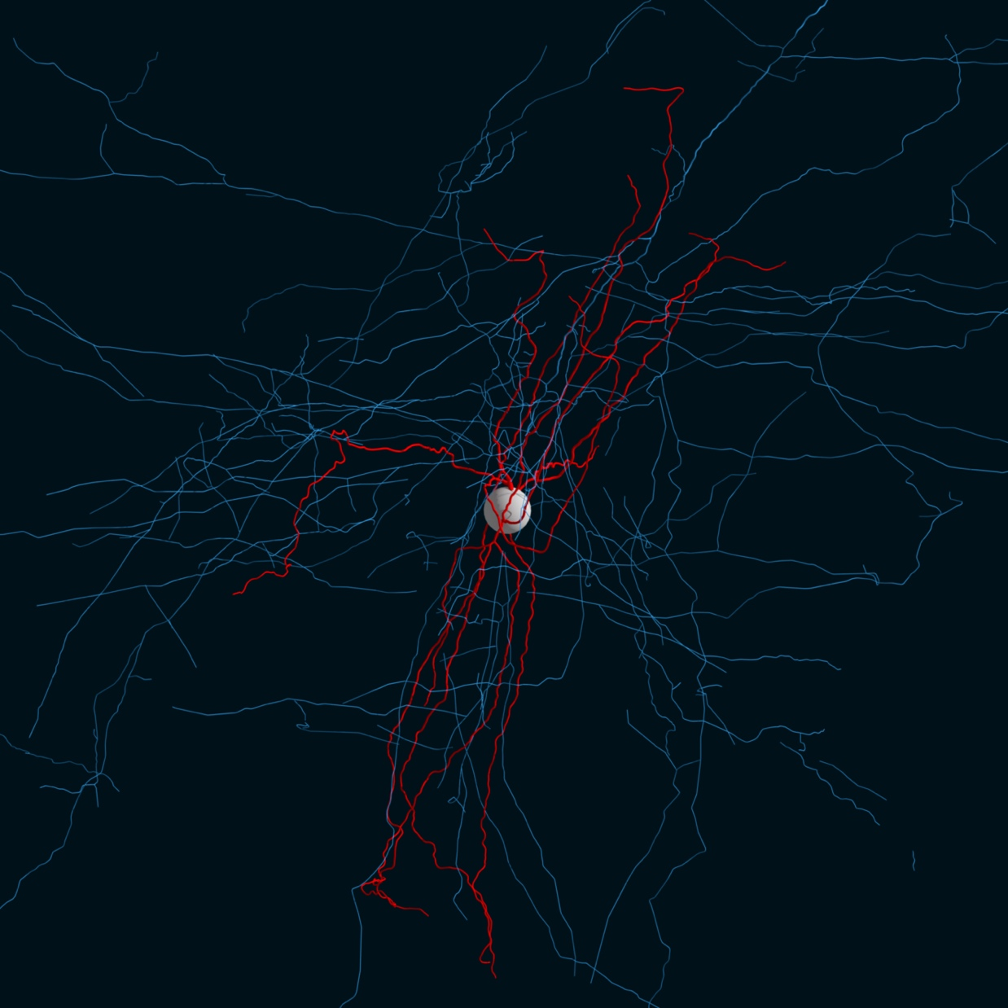
Neuron under microscope
This part of a neuron contains the nucleus and organelles that are also found in any other cell
Dendrites and axons project out from this part of the cell
Digital reconstruction of same neuron, white ball marks this structure
Notes:
Soma

Slide 9
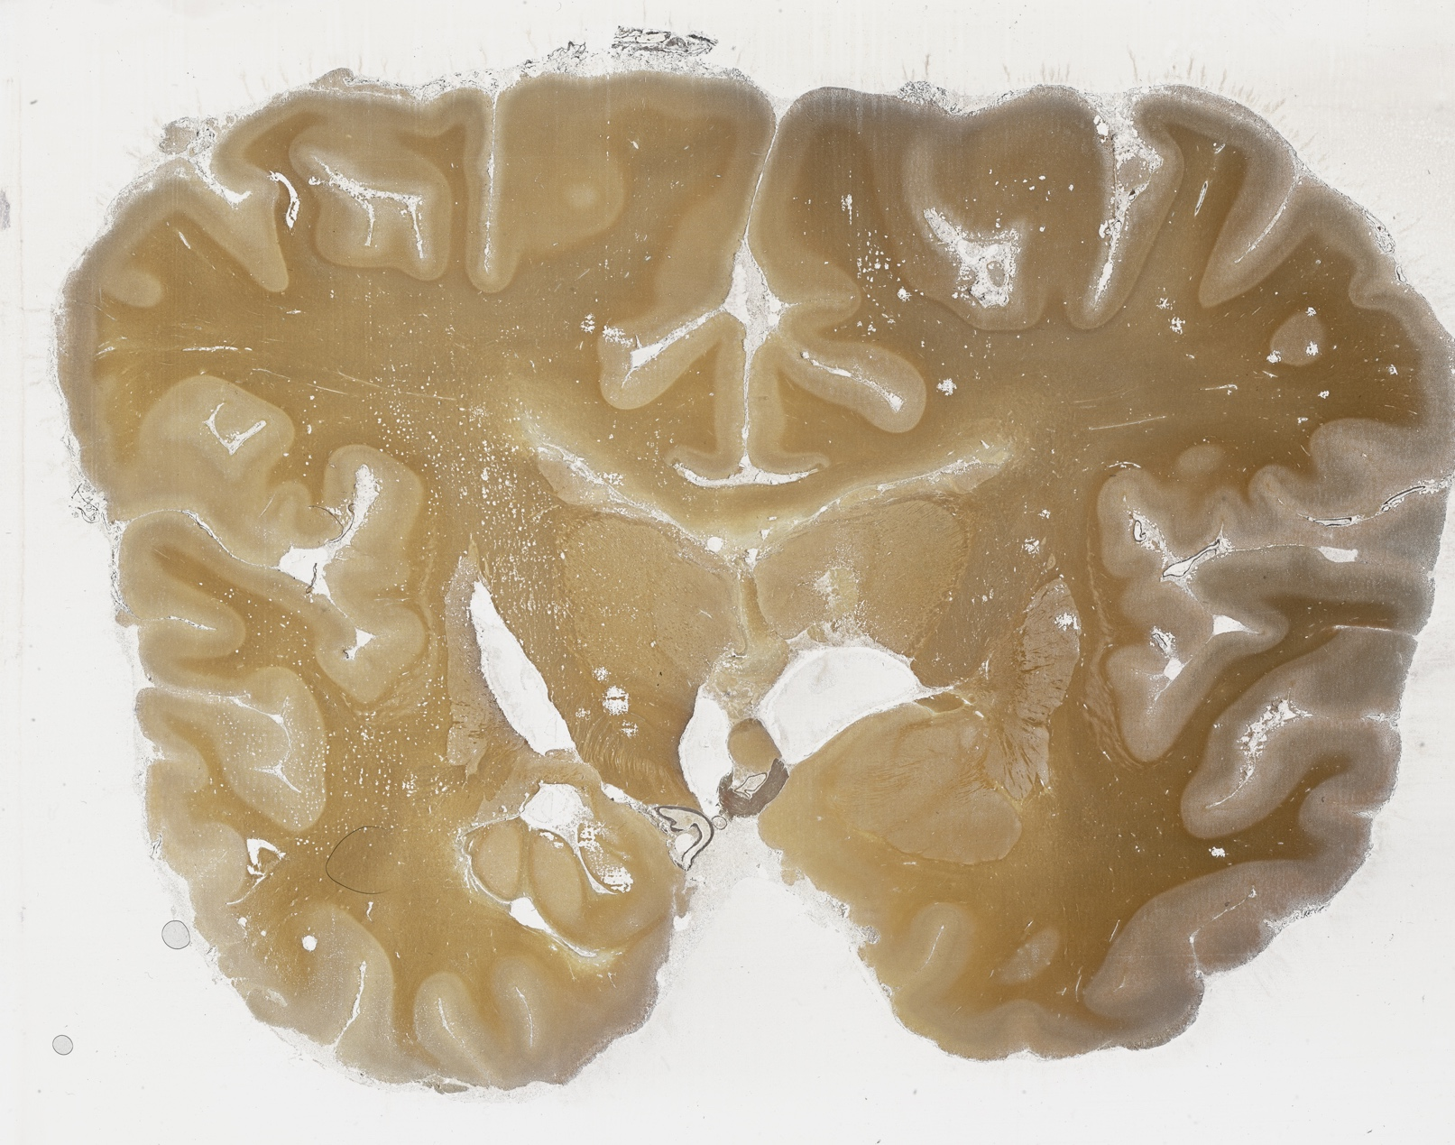
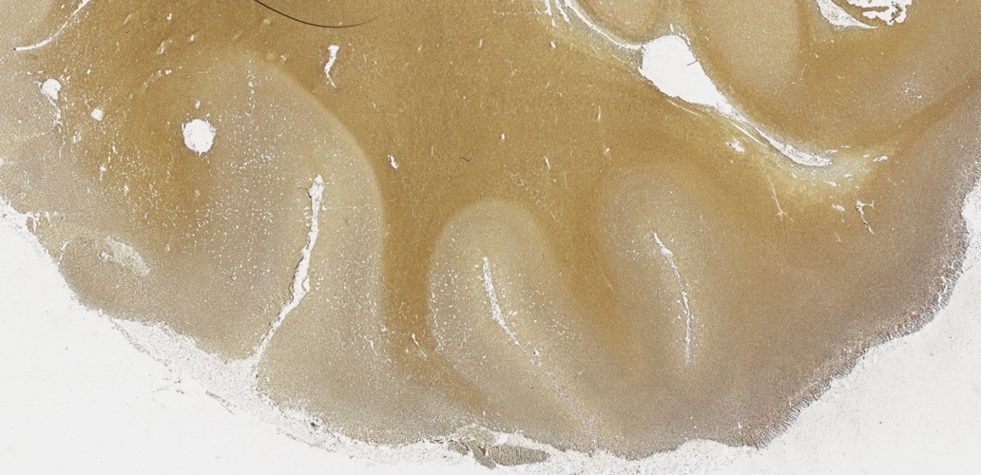
The outer layer of the cerebrum, which is often wrinkled to increase the available surface area
In humans, it is comprised of six layers of neurons, each of which have distinct patterns of cell types, projections to and from other areas, and projections to other layers
Image information: The large upper image shows how this outer layer is found all over the cerebrum, and the inset shows how it is distinct from the tissue adjacent to it
Notes:
Cerebral cortex

Slide 10
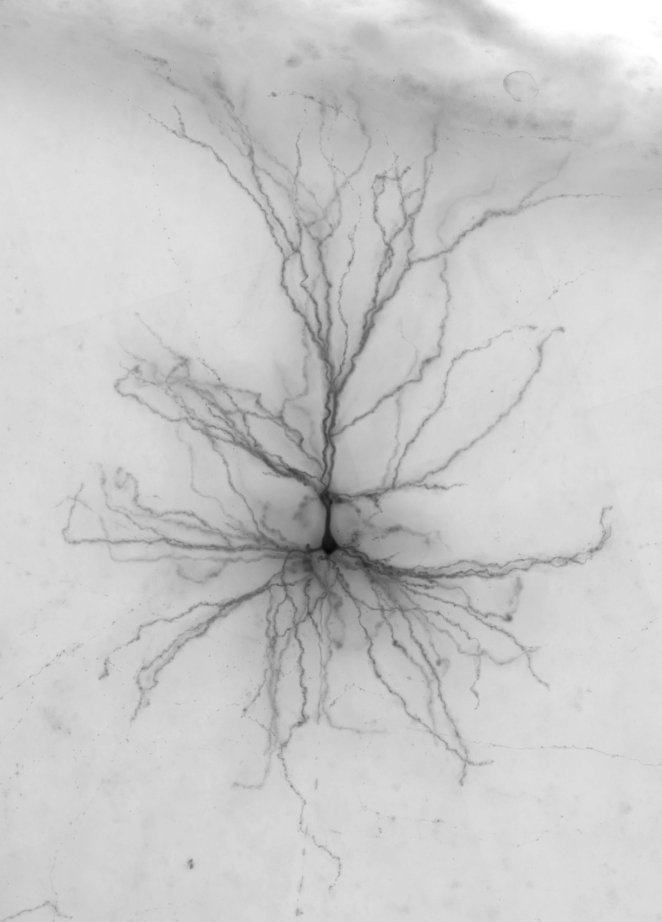
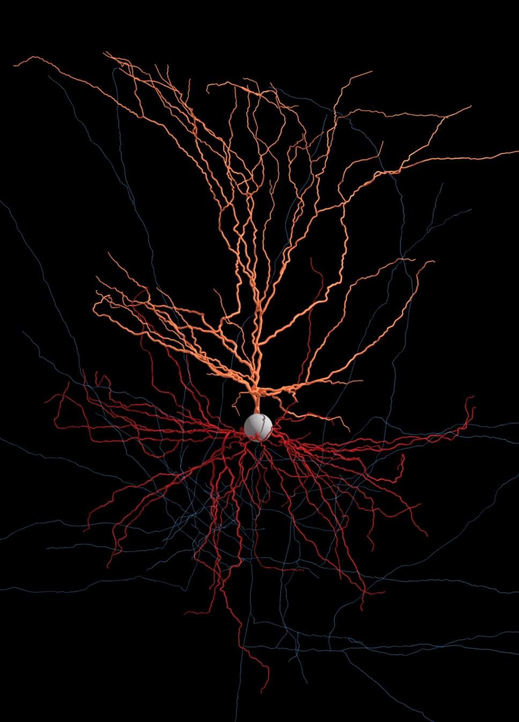
Neuron under microscope
A projection or projections from a neuron that receive and then carry signals from other cells
They are part of neurons both inside the brain and across the body
A signal received here may generate an action potential
Digital reconstruction of same neuron, red and orange mark two types of this structure
Notes:
Dendrite

Slide 11
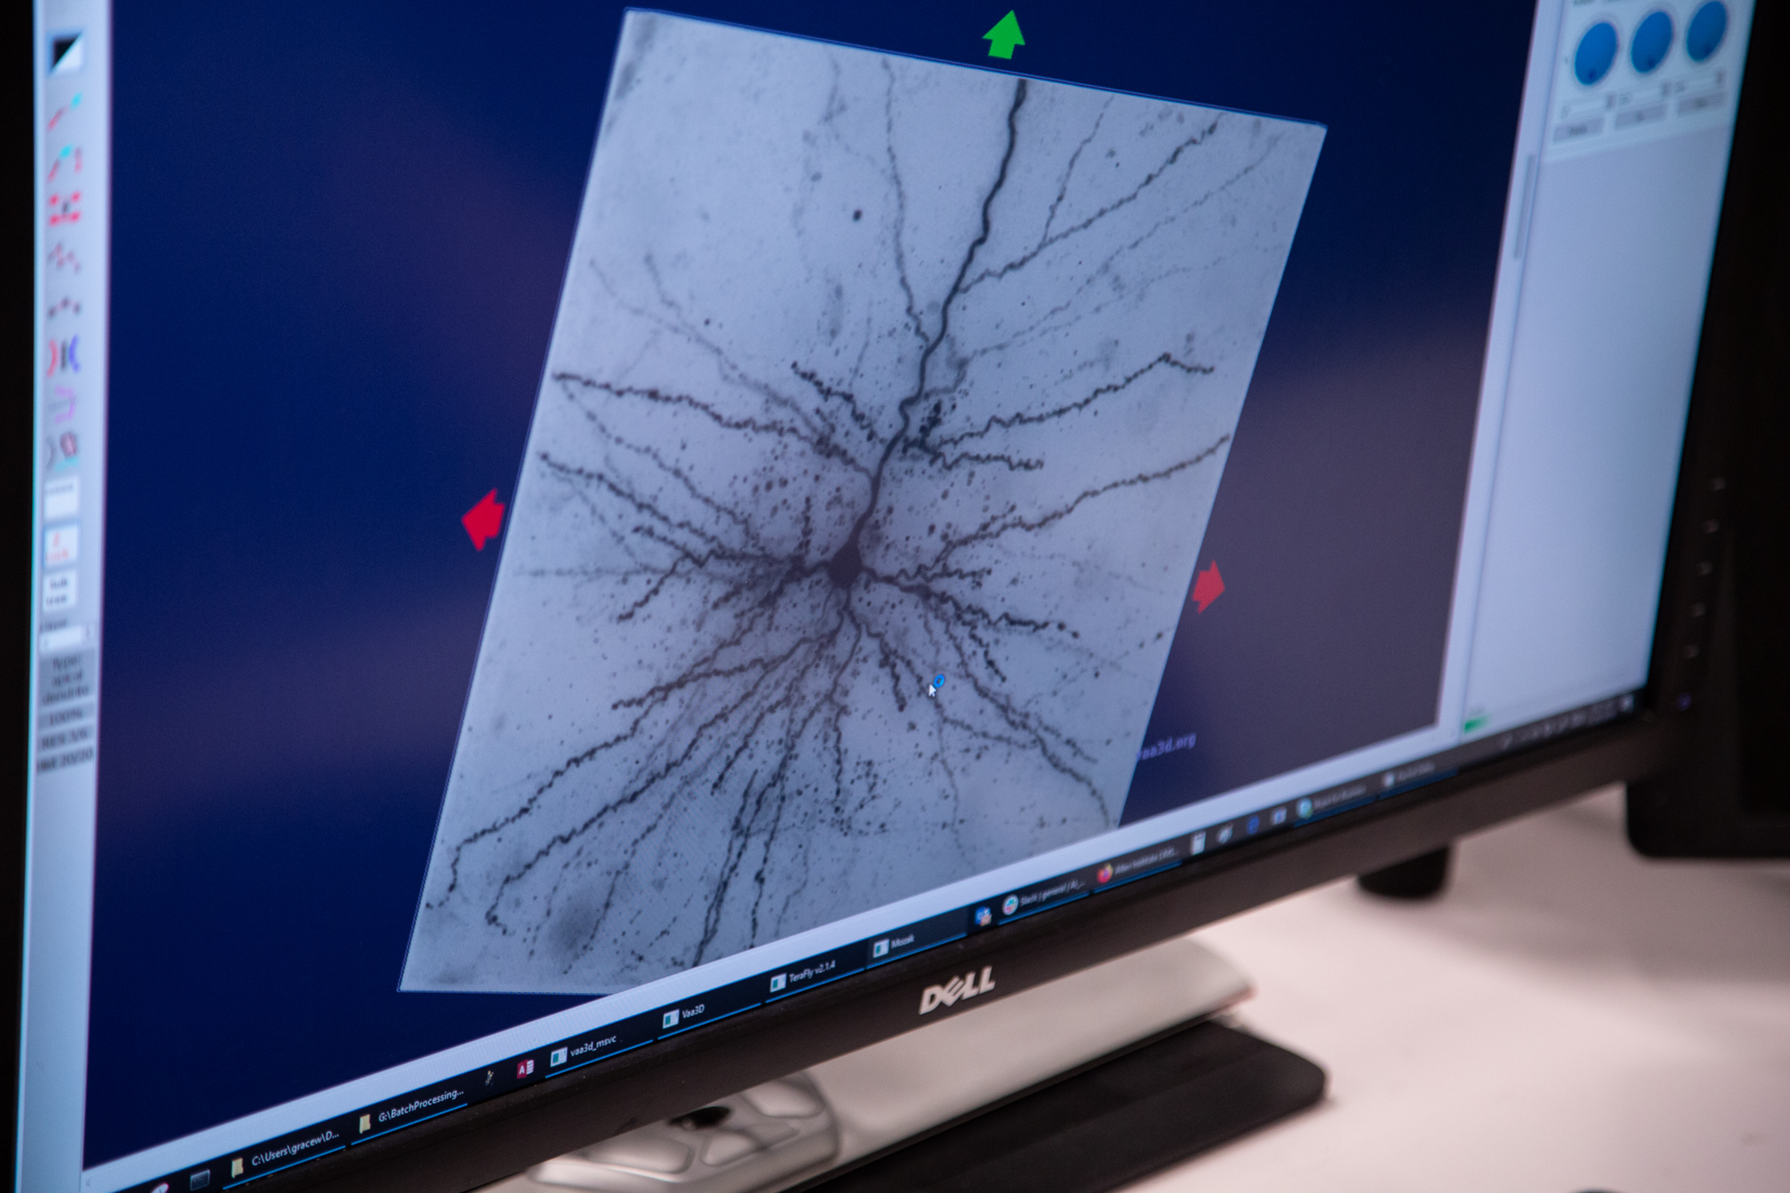
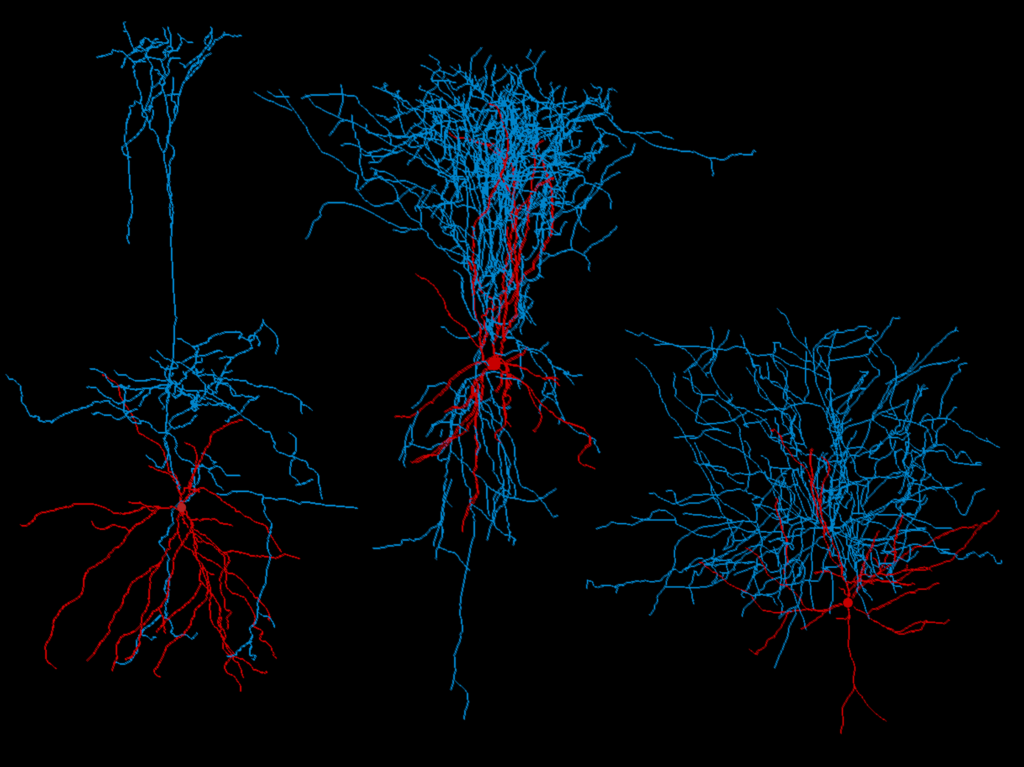
This neuron is being digitally traced to create a reconstruction
The properties of a neuron’s shape, which can be evaluated both qualitatively and quantitatively
A common way this property of a neuron can be visualized by injecting the cell with dye and taking a three-dimensional array of images of it
These reconstructions let scientists quantify and study this property of neurons
Notes:
Morphology

Slide 12
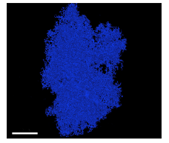
A particular type of glia that provides nutrients, removes waste, and helps support synapses, especially by recycling neurotransmitters
Forms part of the blood-brain barrier by physically wrapping around blood vessels to allow only selected molecules to reach the brain
Gets its name from its “star” shape
Image information: a reconstruction of this type of cell from electron microscopy images of the mouse brain
30µm
Notes:
Astrocyte

Slide 13
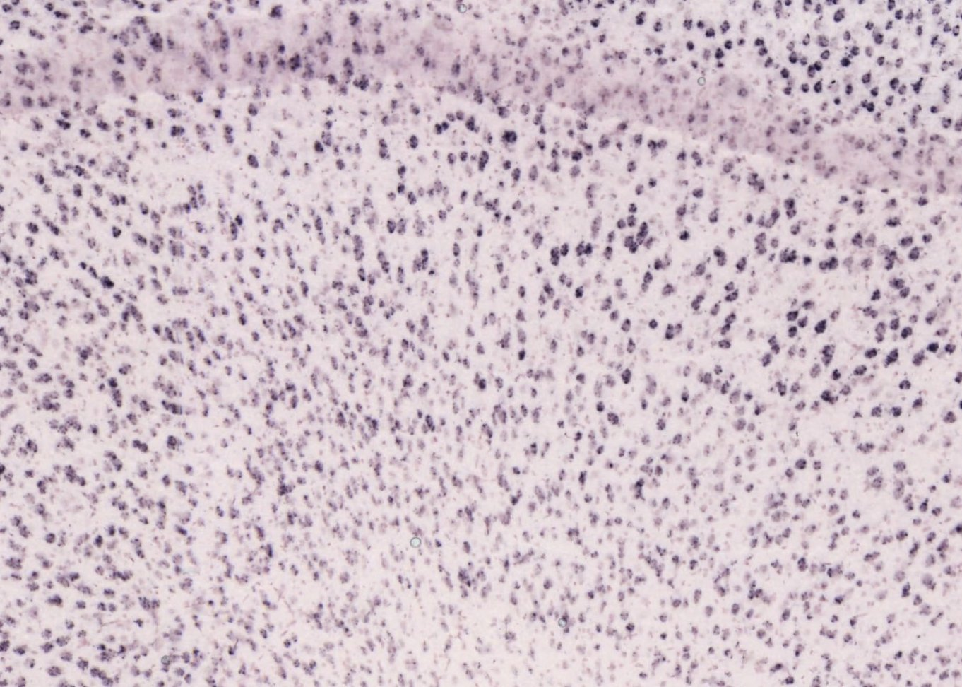
Portions of brain tissue that are primarily comprised of neuronal cell bodies
These cell bodies may or may not organize into layers
Gets its name from its color
Image information: tissue of this type with the cell bodies stained
Notes:
Gray matter

Slide 14
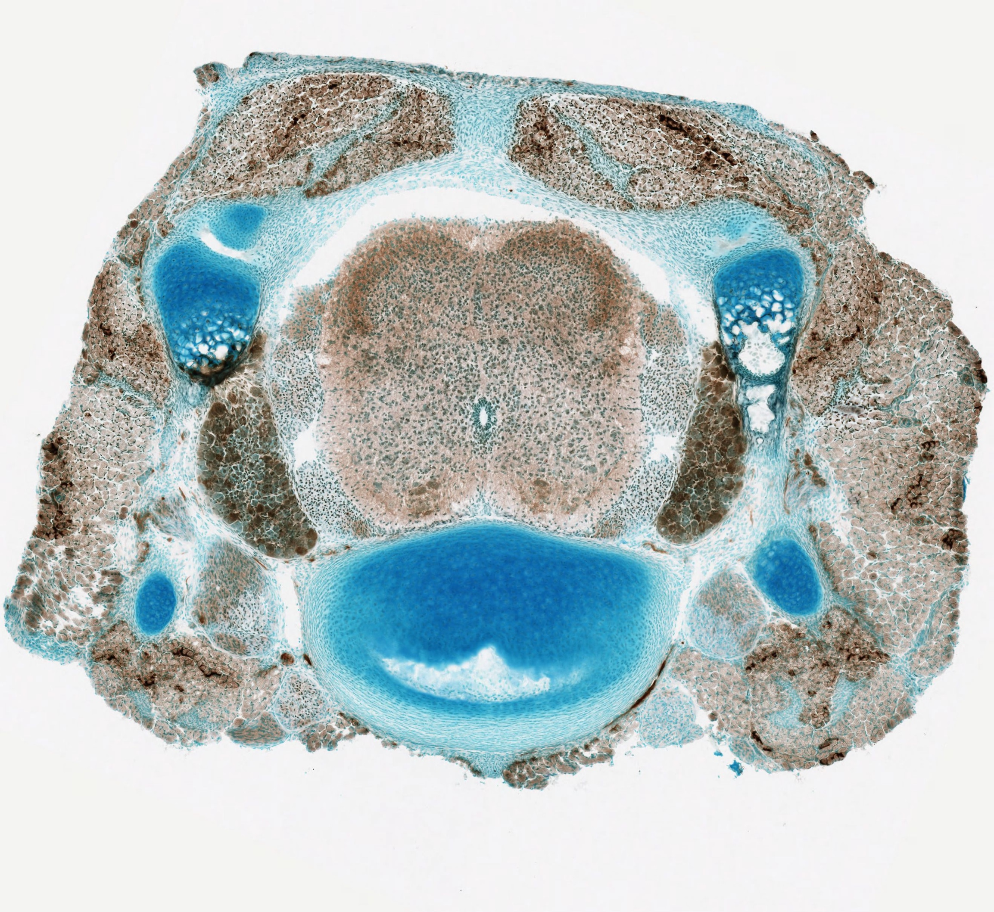
The major pathway for nervous system signals to travel between the brain and body
Protected by the vertebrae and meninges
Extends from the base of the brainstem
Along with the brain, is part of the central nervous system
Image information: this structure in the mouse, showing that it is divided into many sub-structures that organize different types of signals (sensory, motor, destination/source body part)
Notes:
Spinal cord

Slide 15
A structure located deep in the brain that is critical for memory
Composed of allocortex, which is made of neurons that organize into less than six cortical layers
Gets its name from its shape, which somewhat resembles a seahorse
Image information: this structure in a human brain that has been Nissl stained to show cell bodies
Notes:
Hippocampus

Slide 16
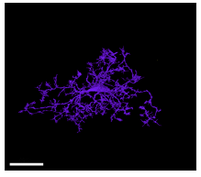
A particular type of glia that carries out immune functions in the brain
They clean up general damage like dying neurons and protein plaques
They also eliminate threats like pathogens that manage to pass through the blood-brain barrier
Found throughout the brain and spinal cord
Image information: a reconstruction of this type of cell from electron microscopy images of the mouse brain
30µm
Notes:
Microglia

Slide 17
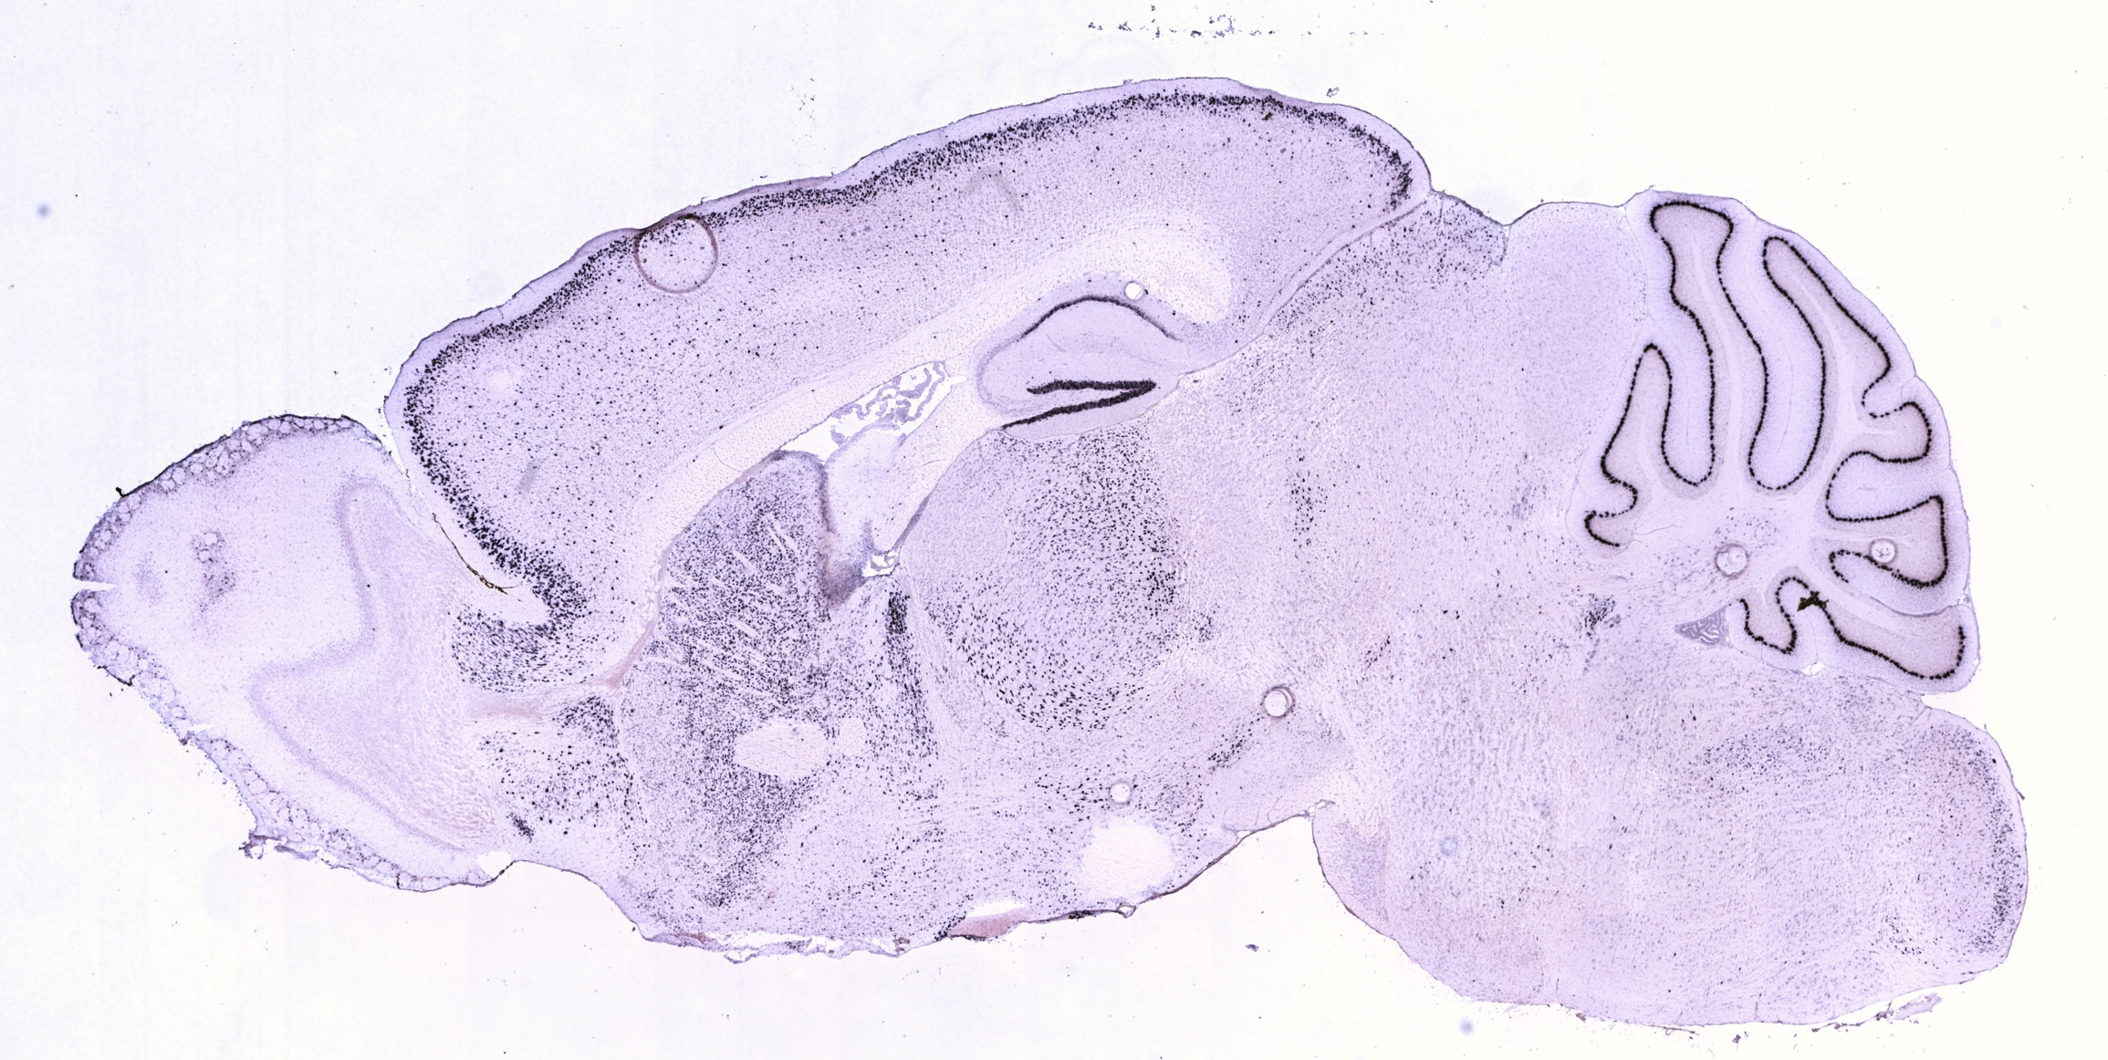
One of the three planes used to view the three-dimensional brain in two-dimensional slices
This plane slices the brain with vertical cuts that divide the brain into medial (closer to the middle) and lateral (closer to the edge) sections
These planes run parallel to the longitudinal fissure, which divides the left and right hemispheres
Image information: a section of mouse brain in this plane stained to show the presence of cell bodies
Notes:
Sagittal

Slide 18
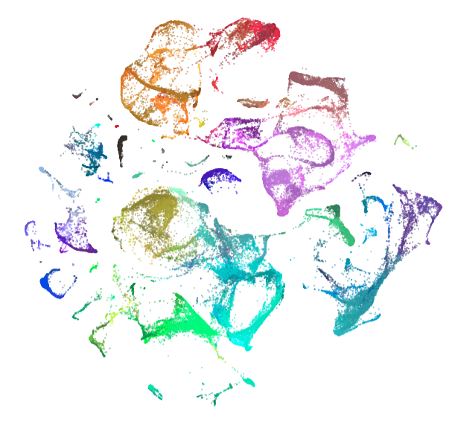
Neurons can be organized and characterized with these categories
Categorizing neurons in this way helps scientists understand their properties and interactions, the way they change over development or in diseases, and more
Properties that can be used to develop these classifications include transcriptomic profile, electrophysiological properties, shape, or a combination of all three
Image information: Each point in the figure represents the transcriptomic profile of one neuron; clusters on the plot represent groups of neurons that are more like each other than they are like other cells
Notes:
Cell types

Slide 19
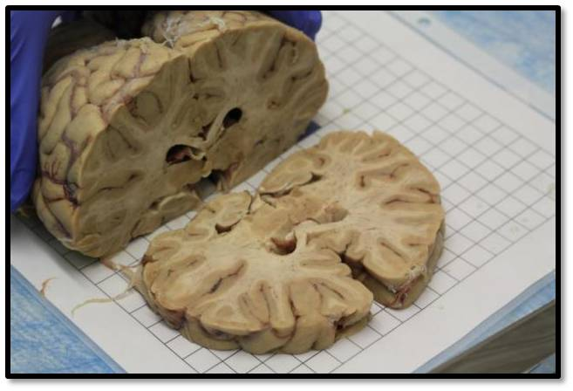
Portions of brain tissue that are primarily comprised of myelinated axons, and no cell bodies
These axons are myelinated to help axonal signals travel faster
Gets its name from its color
Image information: a brain being dissected with tissue of this type labeled
Notes:
White matter

Slide 20
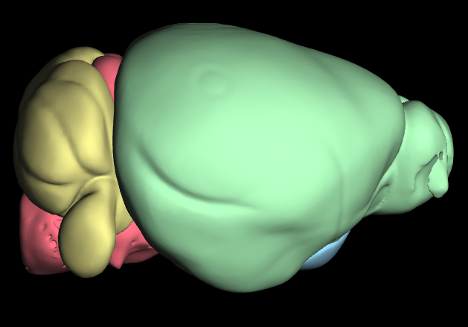
This large structure is located posterior to the cortex and dorsal to the brainstem
Its functions are still poorly understood, but it is known to be involved in coordinating and refining motor commands
It may also be involved in motor learning and other cognitive functions
Region marked in yellow
Notes:
Cerebellum

Slide 21
The routes that visual signals travel between the retina and the primary visual cortex, located in the occipital lobe
At the optic chiasm, part of the visual signal crosses to the contralateral hemisphere from that eye and some remains ipsilateral; this aids in 3D processing
Video information: a series of slices in the mouse brain, arranged anterior to posterior; the fluorescent green signal shows neurons traveling the part of this pathway after the optic chiasm
Notes:
Optic nerve and tract

Slide 22
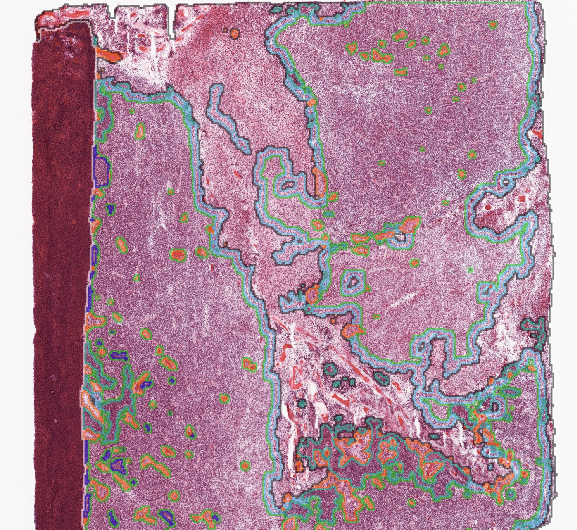
A very aggressive type of brain tumor
One of the more common brain cancers
Most often occurs in older adults
May originate in glia, which gives this type of cancer its name
Image information: a labeled histopathology image of a tumor of this type; the annotations show the boundaries of features like necrotic tissue, tumor tissue, and healthy tissue
Notes:
Glioblastoma

Slide 23
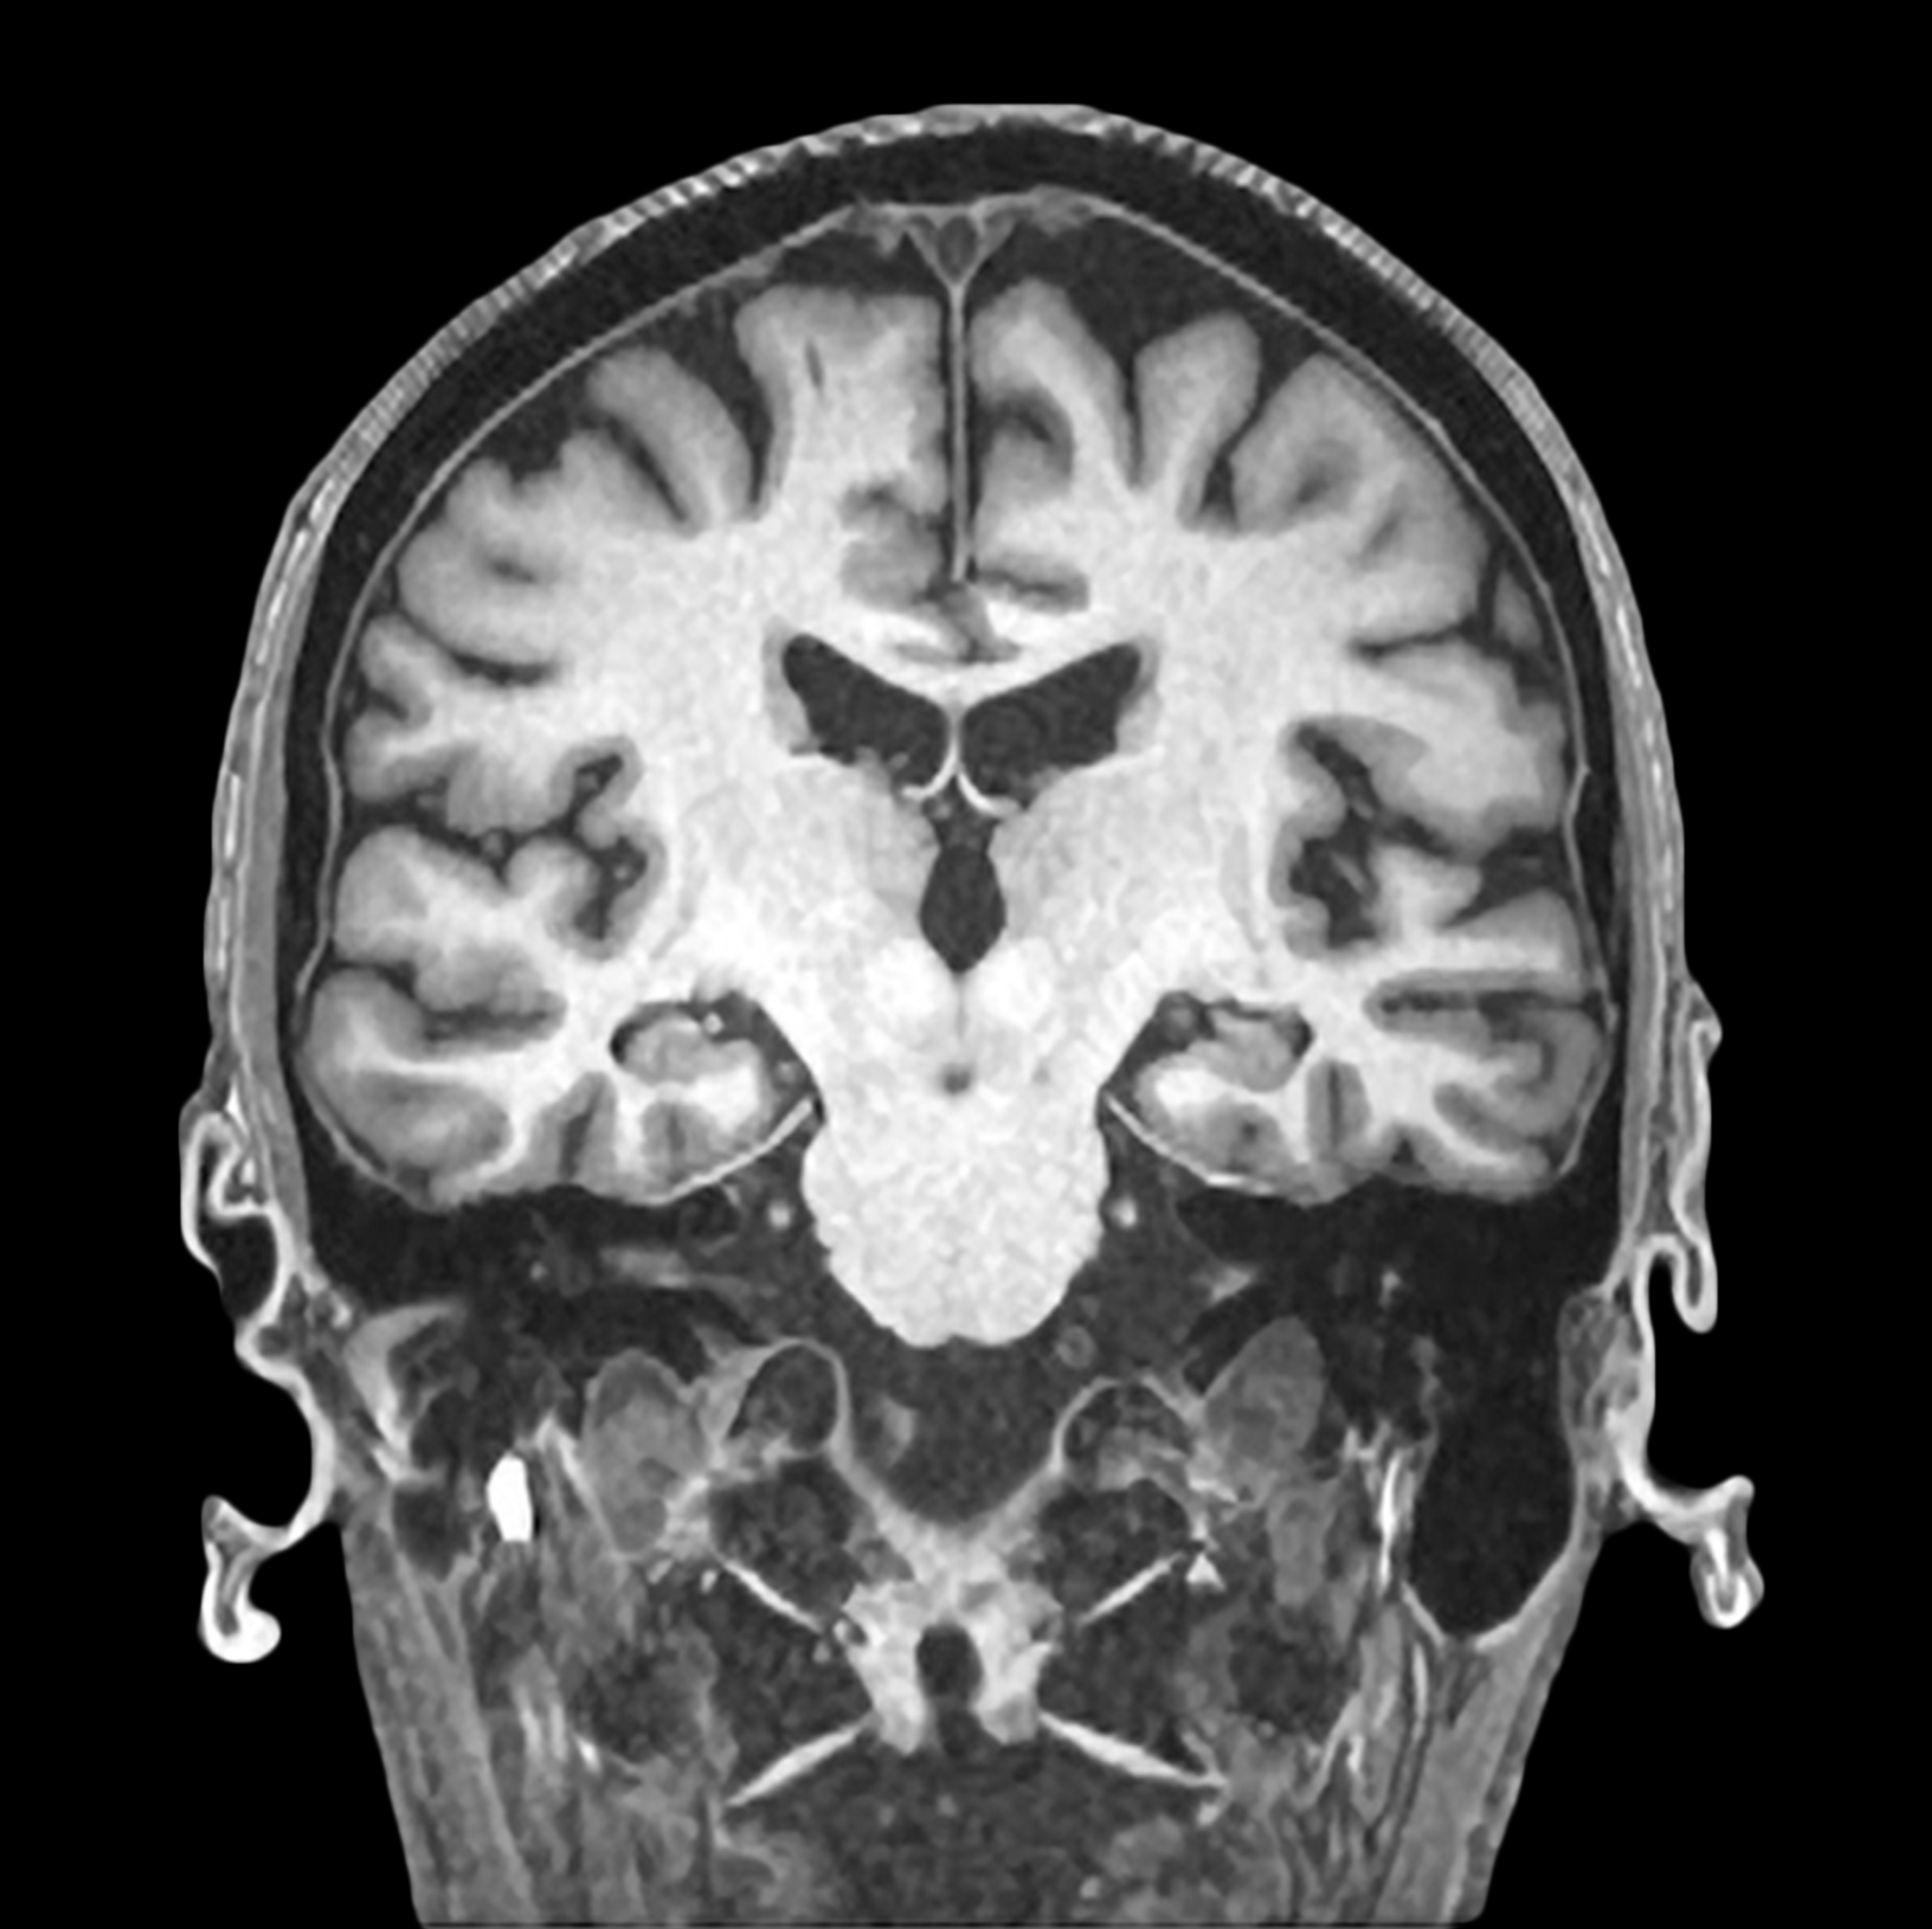
This division of the nervous system mainly comprises the brain and spinal cord
The brain and spinal cord are enclosed within the meninges for protection
It also includes the retina and cranial nerves, which extend outside of the meninges
Communicates with the peripheral nervous system to receive sensory input and send motor commands
Image information: an MRI of a human brain, one of the two main components of this division of the nervous system
Notes:
Central nervous system

Slide 24
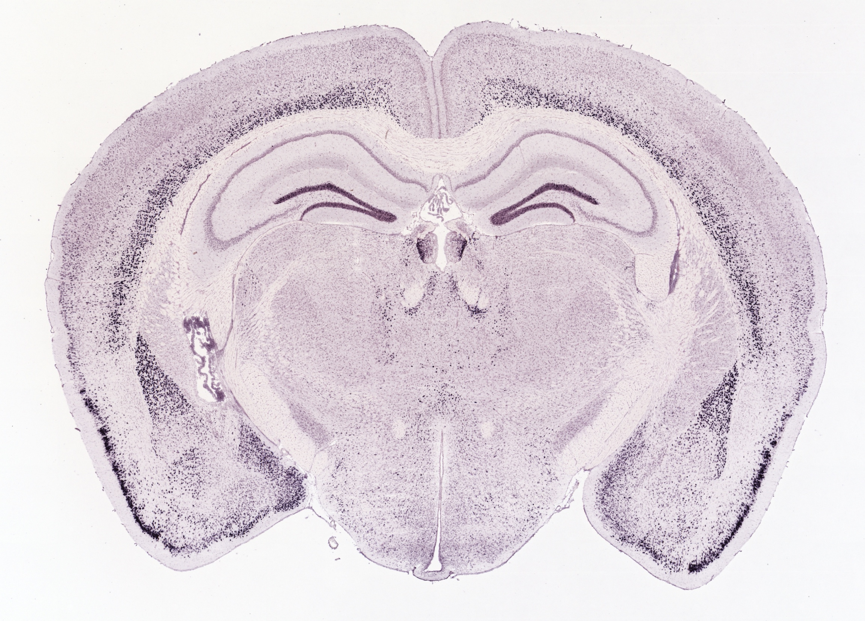
One of the three planes used to view the three-dimensional brain in two-dimensional slices
This plane slices the brain with vertical cuts that divide the brain into front and rear (anterior and posterior) sections
These planes run parallel to the face
Image information: a section of mouse brain in this plane stained to show the presence of cell bodies
Notes:
Coronal

Slide 25
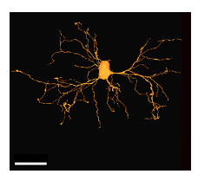
A particular type of glia that forms myelin sheaths around neurons
This myelin sheath helps action potentials travel more quickly and efficiently
Found in the central nervous system; Schwann cells perform a similar role in the peripheral nervous system
Image information: a reconstruction of this type of cell from electron microscopy images of the mouse brain
30µm
Notes:
Oligodendrocyte

Slide 26
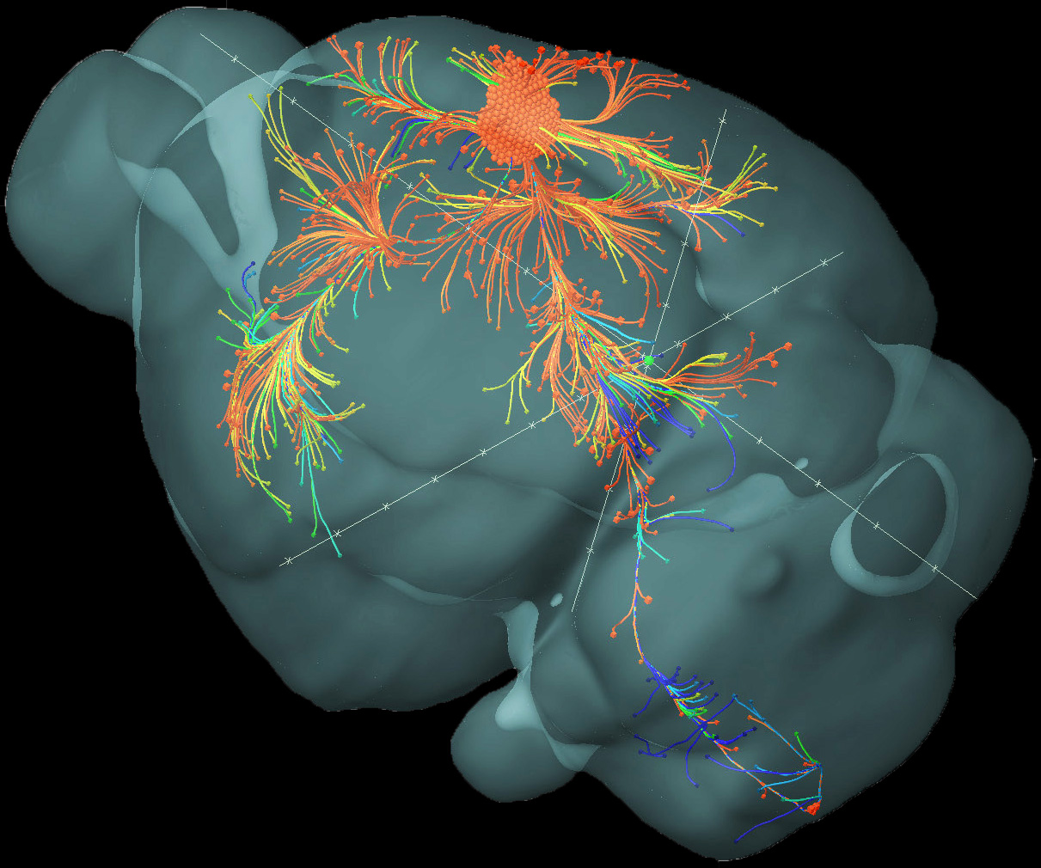
A region in the frontal cortex that is responsible for executing movements
The left side of the brain controls the right side of the body, and vice versa
Specific regions of this region correspond to individual body parts
Image information: the paths taken by neurons projecting from this brain region – the cluster of orange dots near the top center of the image represents the source of these projections; the projection that travels to the bottom right of the brain model is reaching the brainstem and into the spinal cord
Notes:
Motor cortex

